Slide 1
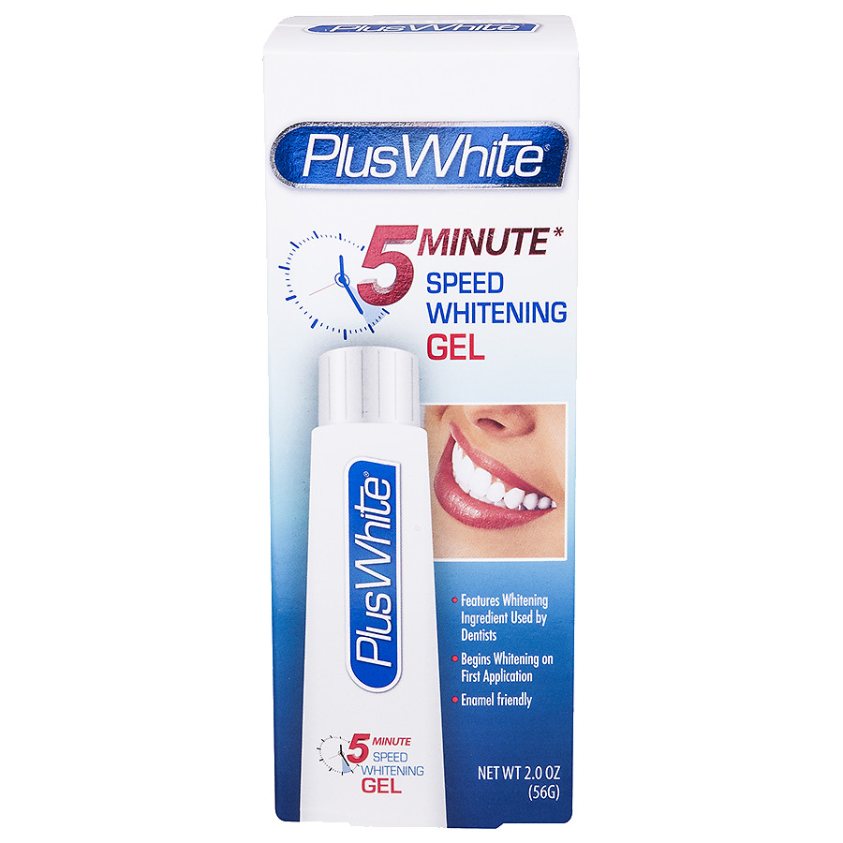
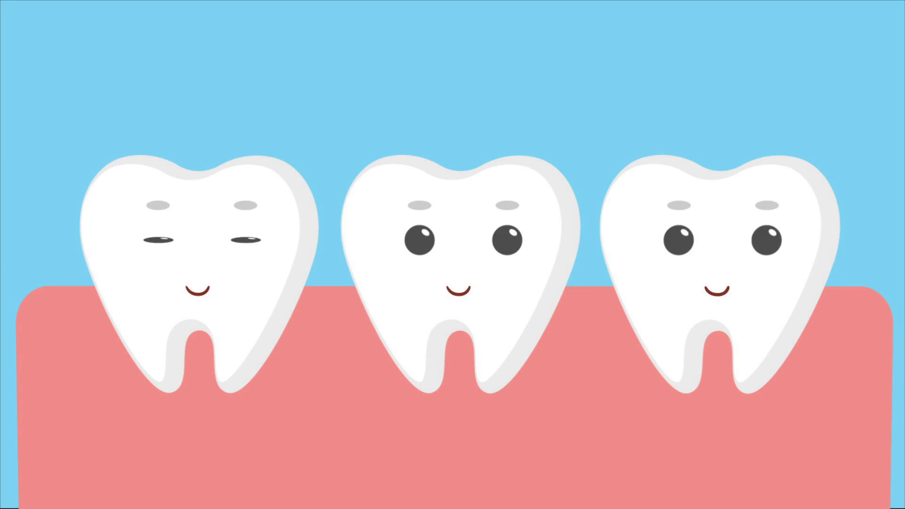
Advancements in Dental Technology and Materials

Slide 2
Advancements in Technology
High tech X-rays and Digital X-rays
Use of lasers including diode laser
Teledentistry
Biomaterials

Slide 3
Advancements in Materials
Thinner veneers
Better bonding material for implants and crowns
Bio inert
Bio active
Smart materials e.g. thermo-responsive materials, magnetic shape memory alloys.
Prosthetic dentistry – smart ceramics/impression compounds

Slide 4
References
https://www.allsmilesdentist.com/recent-advancements-dental-treatment/
https://www.straightteethdirect.com/teledentistry-101/
http://www.irishdentistry.ie/88307-2/
https://www.sharecare.com/health/teeth-whitening/upcoming-advancements-teeth-whitening-technology
https://www.opalescence.com/za/pages/press-room.aspx?article-name=Benefits%20of%20Potassium%20Nitrate%20and%20Fluoride
https://www.omicsonline.org/scholarly/bio-inert-materials-journals-articles-ppts-list.php
https://www.dentistrytoday.com/829-hygiene-today/10299-focus-on-bioactive-dental-materials

Slide 5
Teeth Whitening
A time-released gel that contains 6% hydrogen peroxide when applied, but increases to 10% over the course of five to ten minutes - cutting the time the gel is on teeth.
using calcium phosphates in whitening gels, which would help keep teeth healthy and stronger.
fluoride and potassium nitrate found in regular toothpaste help with whitening and reducing sensitivity

