Slide 1
BIOLOGICS

Slide 2
What are Biologics?
A biologic is any drug or pharmaceutical product that is extracted from biological sources.
Biotherapeutics is the fastest growing sector in the pharmaceutical industry – secondary biologics
They are safe and have fewer side effects than past treatment

Slide 3
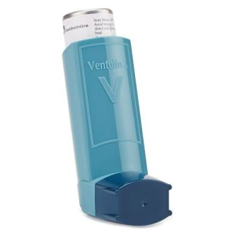
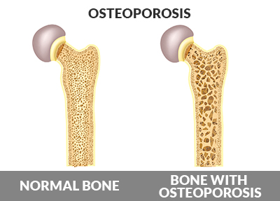
Which diseases do they treat?
Crohn’s
Rheumatoid arthritis
Psoriasis.
Cancer
Allergic asthma
Cystic fibrosis
Osteoporosis
Haemophillia

Slide 4
How do Biologics work?
more specific than previous treatments
autoimmune diseases were treated with immunosuppressants, leading to infection and a higher demand for antibiotics.
biologics use a more refined approach.
adalimumab used to treat psoriasis and Crohn’s uses antibodies to block TNF receptors on cells that cause the inflammation.

Slide 5
Cancer and biologics
https://youtu.be/4Ra0fNDFGg4

Slide 6
The first cancer biologic
Bacillus Calmette-Guérin (BCG) was the first biological therapy to be approved by the FDA.
It is a weakened form of a live tuberculosis- first used as a vaccine
When inserted directly into the bladder with a catheter,
BCG stimulates an immune response that is directed against the bacterium itself and cancer cells.
Approximately 70 percent of patients with early bladder cancer went into remission with this treatment.

Slide 7
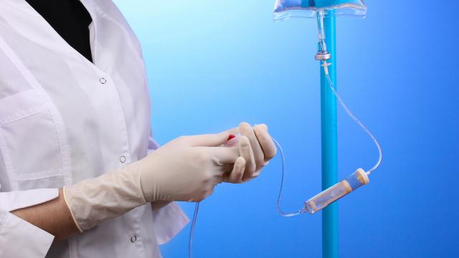
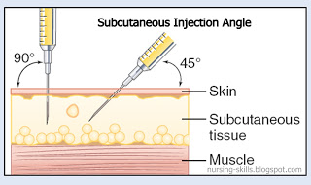
How are they taken?
administered by injection or by infusion- a slow injection through a vein.
biologics would be digested if taken orally as they are proteins.
The injecitons are self administered and go deep under the skin.
Places with the most fat and muscle are ideal such as the front of the thigh and abdomen.

Slide 8
Advantages
Fewer side effects
Will be cheaper in the future
Same drugs can be used for multiple diseases
More being discovered all the time
Could be key to curing cancer

Slide 9
Disadvantages
Very expensive
Difficult to manufacture
serious side effects (very rare)
Effectiveness can wear off over time
Can’t be taken orally
Only people with very severe cases qualify for treatment

Slide 10
Future of biologics
since 1995- still very new
200+ approved drugs, over 1500 in clinical trial
Investigating regenerative therapy
Further research into how biologics can treat cancer.

