Slide 1
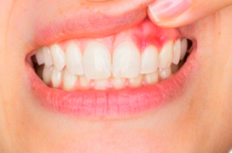
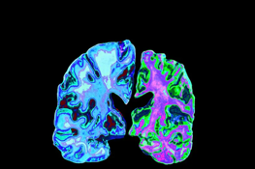
Can gum disease cause Alzheimer’s?
By Freya Goldstone

Slide 2
What is the lie?
Let's play 2 truths and a lie!
1. Gum disease is serious and can always have bad side effects
01
2. Gum disease is caused by bad oral health
02
3. Early Alzheimer's can occur as early as people younger than 65
03

Slide 3
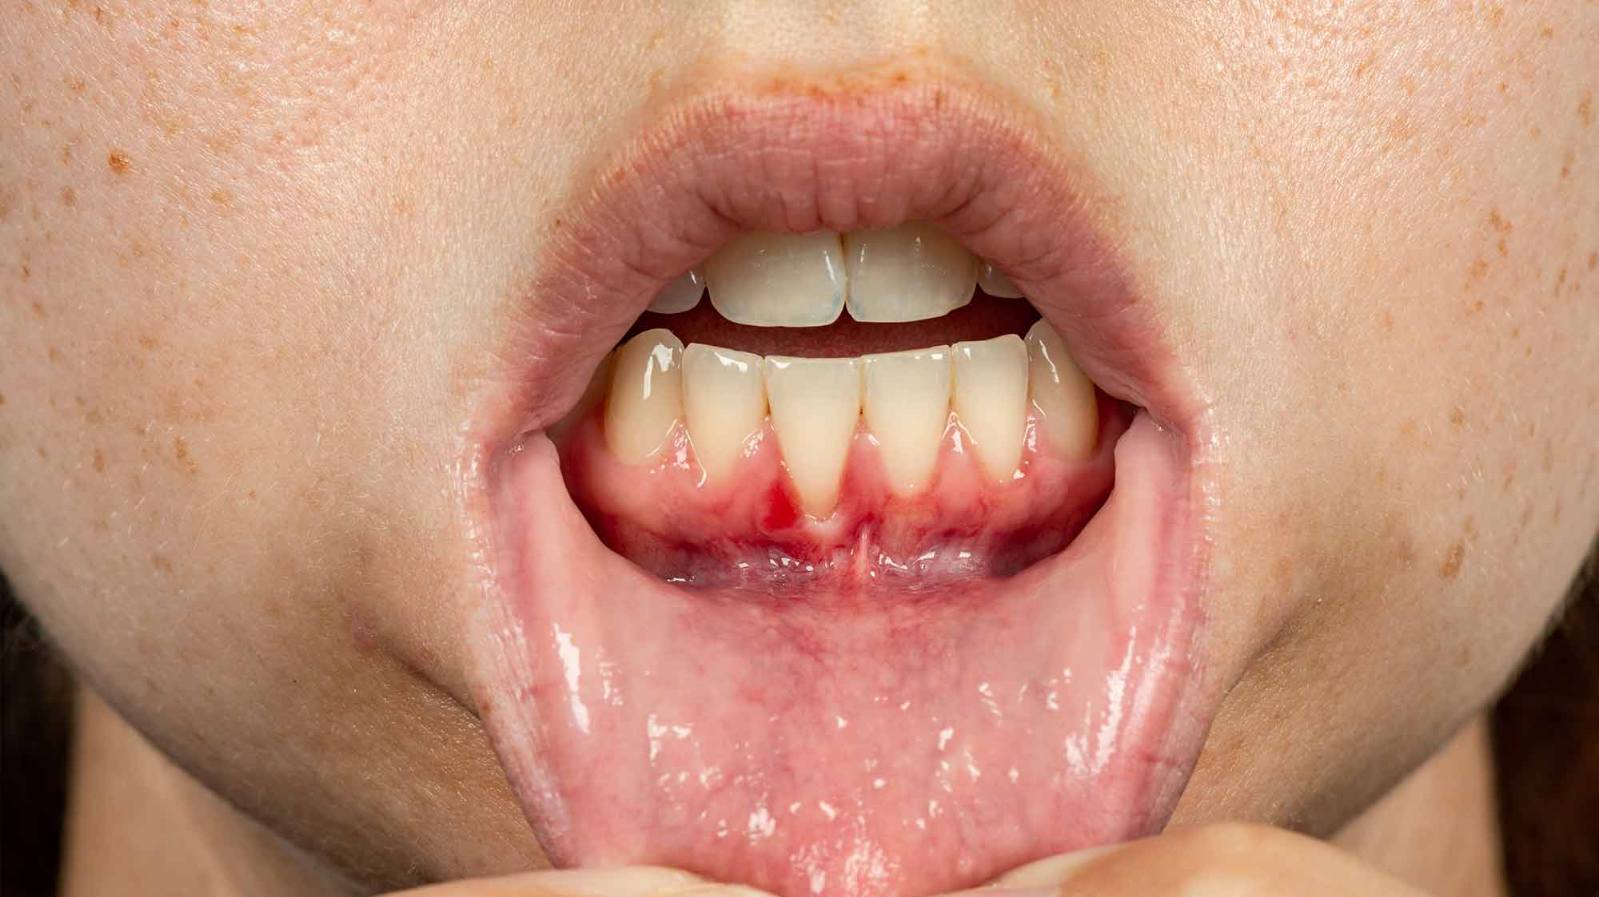
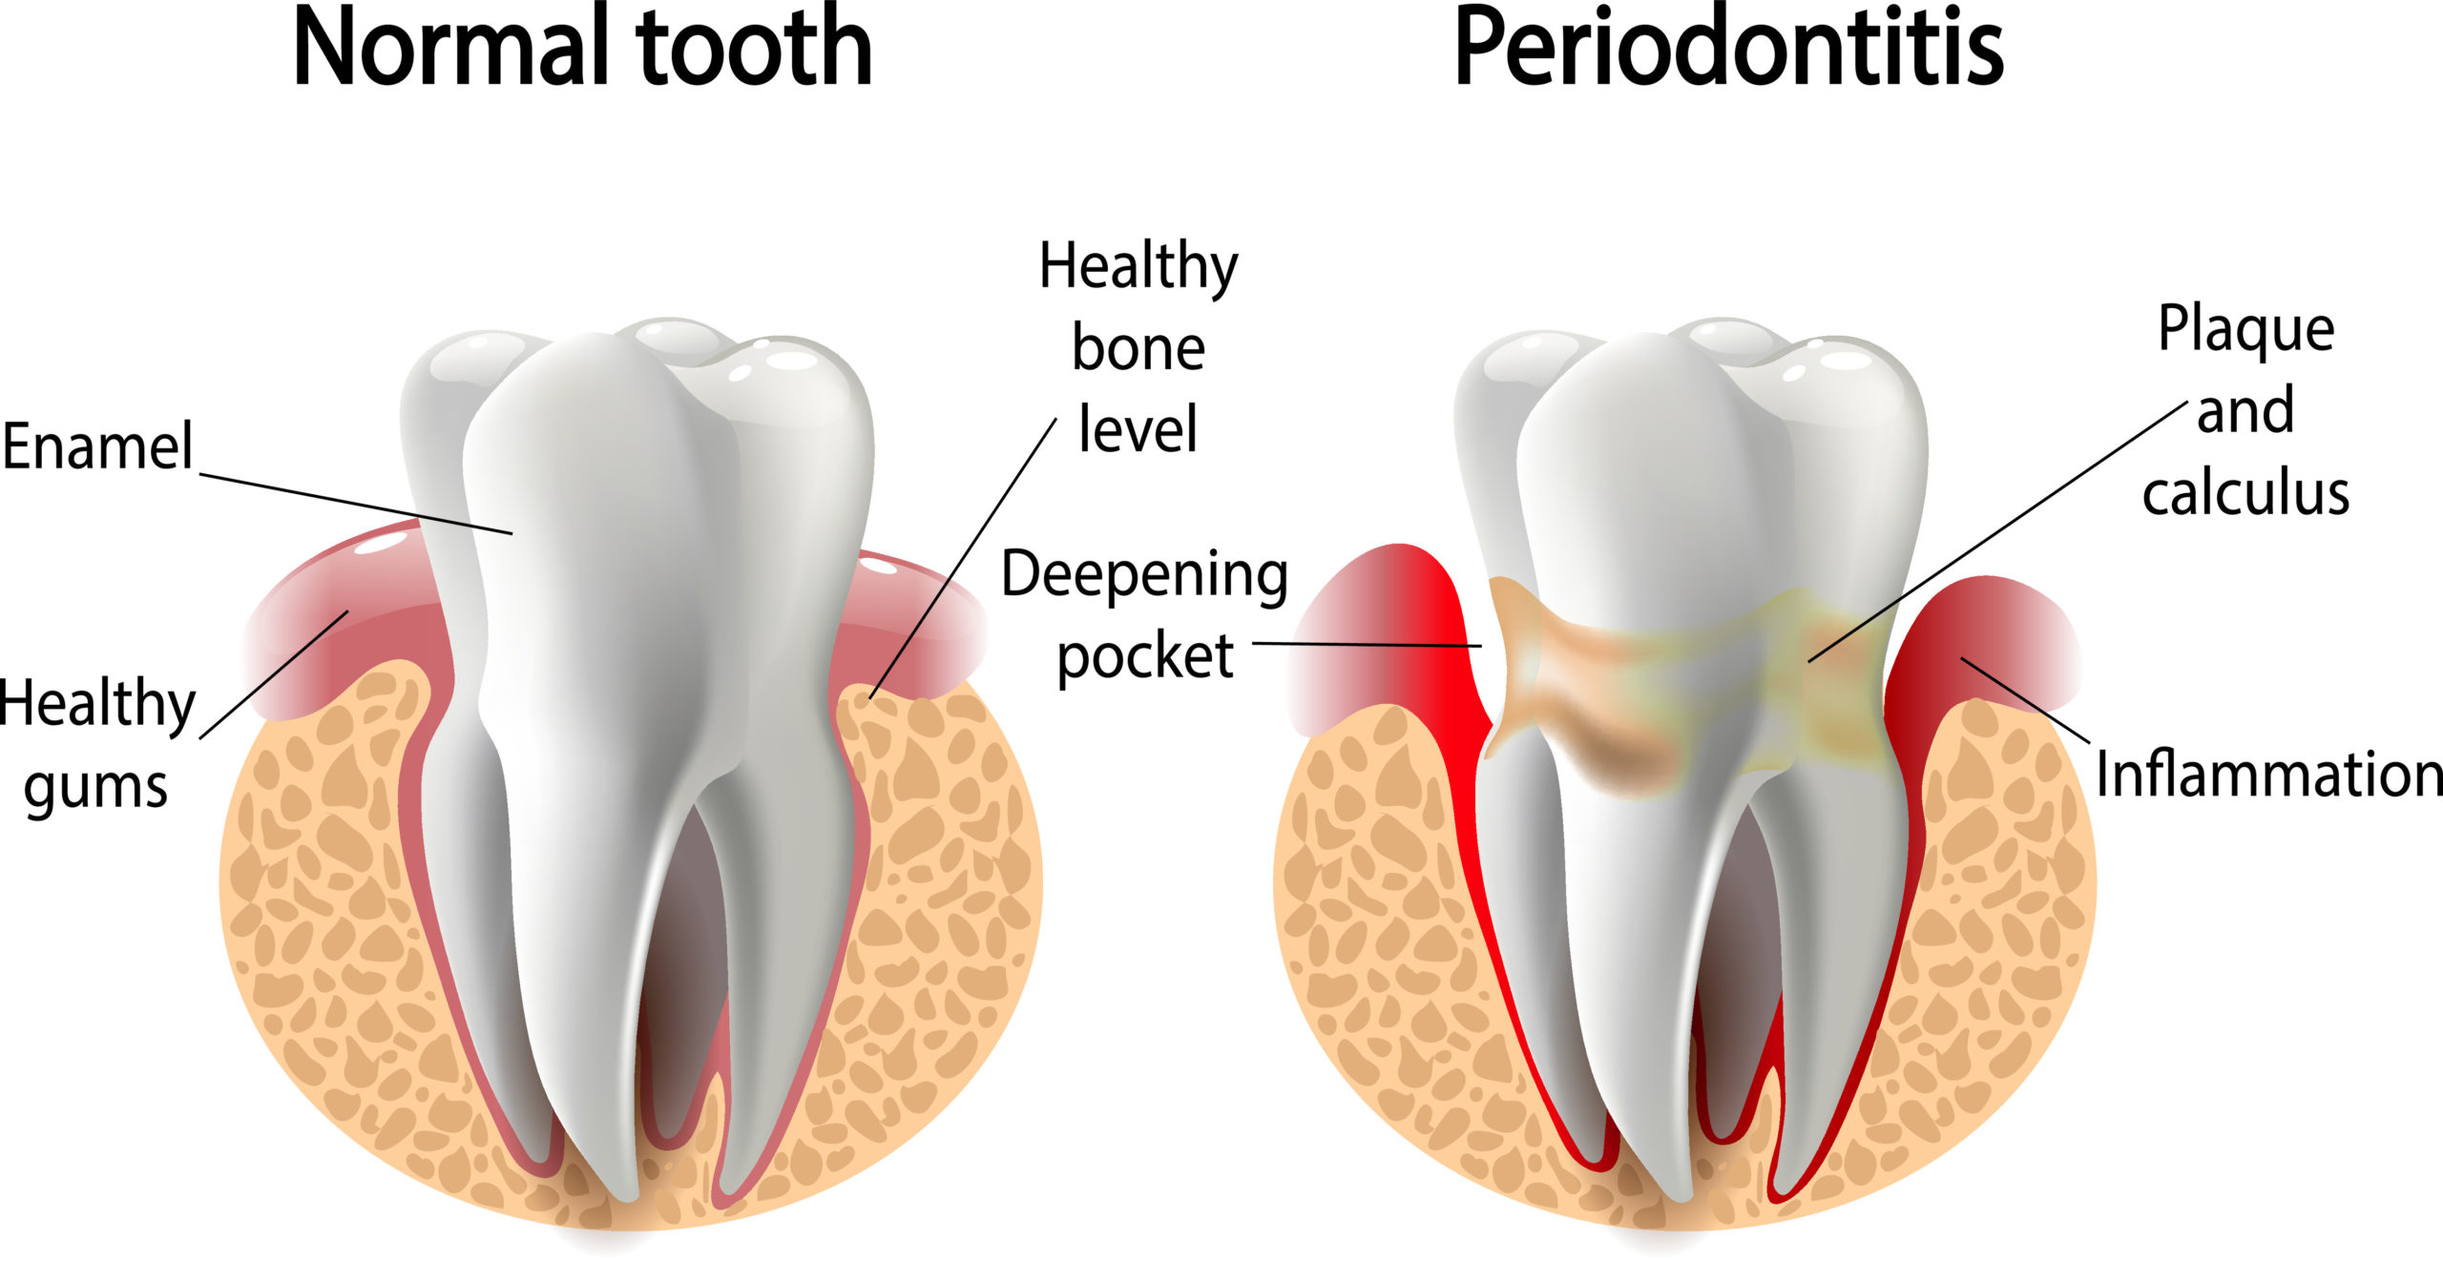
What is Gum disease?
Gum disease occurs when there is a build-up of bacteria in tooth plaque, this causes inflammation, soreness, and bleeding.
Plaque forms due to the chemical reactions that takes place in the mouth when you eat carbohydrates.
The carbohydrates then combine with neutral bacteria in your mouth and create acid
Plaque can destroy your enamel
Plaque remains on the teeth for several days, this can create a substance called tartar which makes your teeth look yellow and can often smell terribly, also can eat away at your enamel.
This can cause inflammation and bacterial toxins and will attack the bone and ligaments.

Slide 4
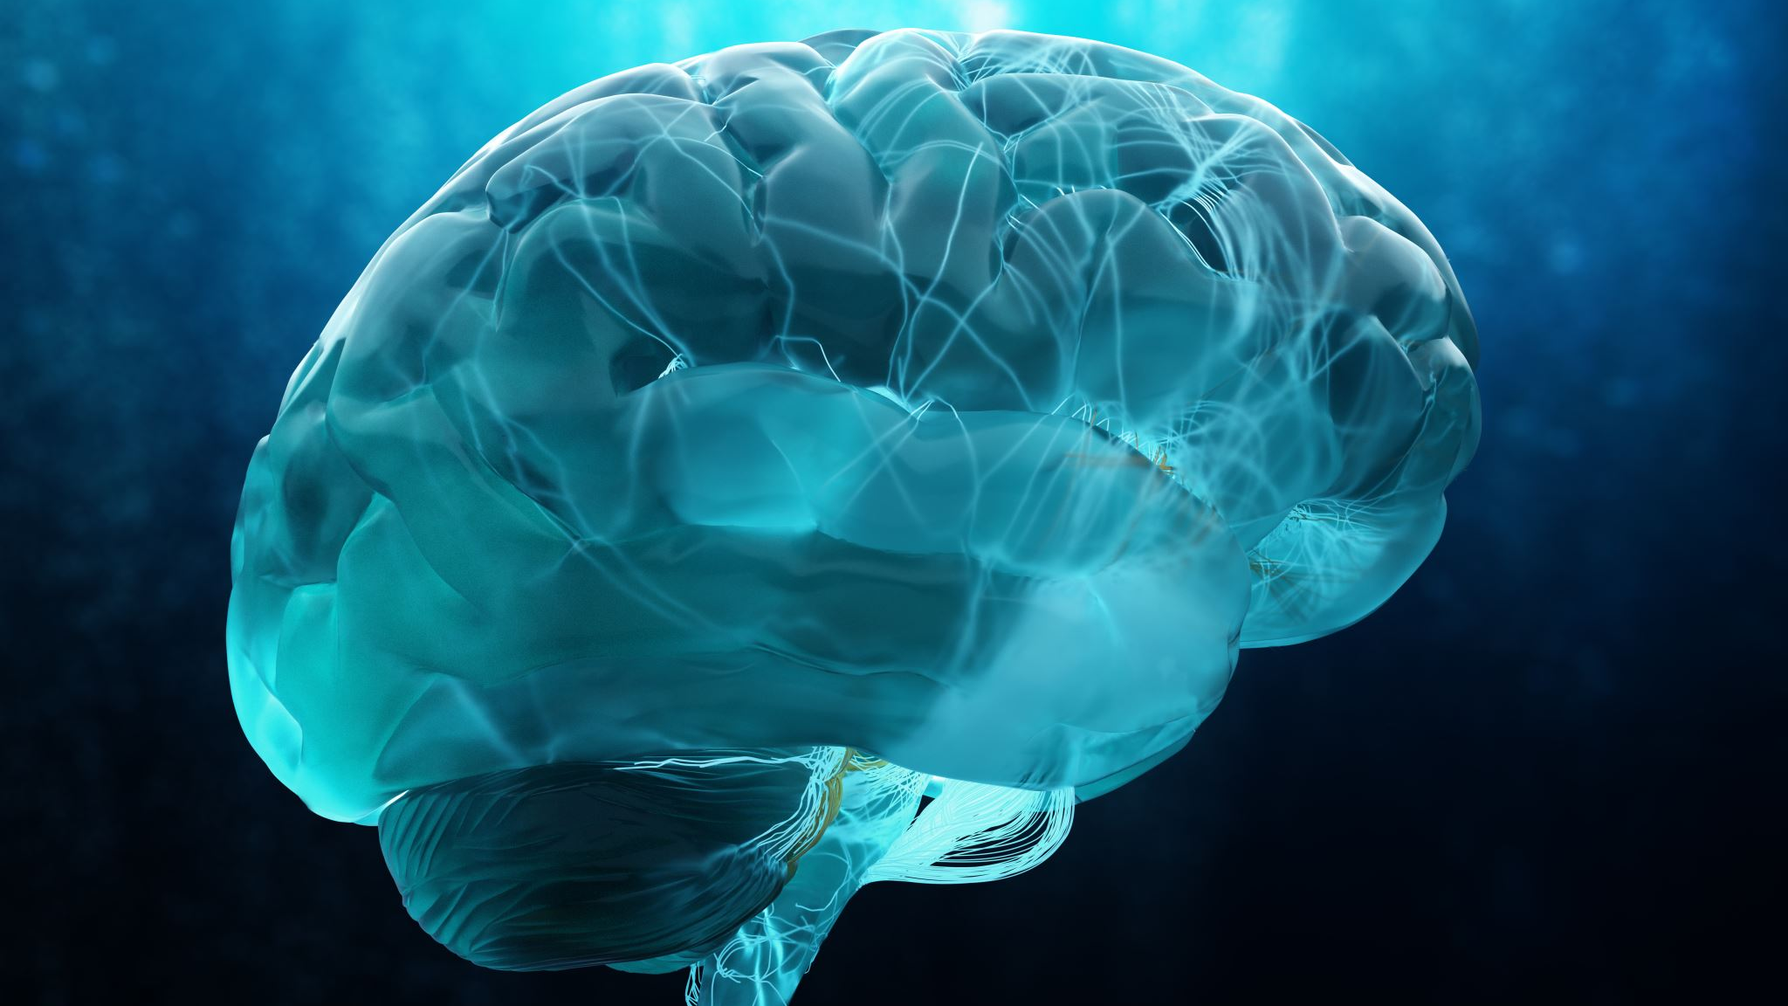
What is Alzheimer's?
Alzheimer’s is a type of dementia. It is a general term for memory loss and other cognitive abilities serious enough to interfere with daily life.
Affects at least 50 million people worldwide.
Alzheimer’s is when the brain shrinks due to the damage off connections among neurons in parts of the brain including mostly memory.
Disrupts vital neurons and their networks, including communication, metabolism, and repair.

Slide 5
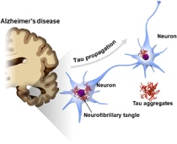
What is Tau?
Tau is a protein that is mostly found in messenger cells called neurons.
Stabilizes the neurons’ structure to help them function best.
In high levels of this tau, it can impact communication between brain cells and throw them off balance.
The build-up of tau is not just disposed of through cells in the usual way of disposing ‘rubbish’ and it can disrupt the neuron’s function.
Tau tangles start in the brain stem
The number of tangles of tau is related to the severity of the disease.

Slide 6
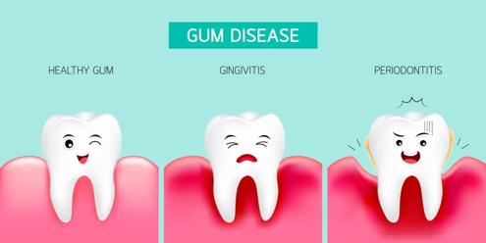
If gum disease is a cause of Alzheimer’s, why were there very few cases of Alzheimer’s when people many years ago didn’t take much care in their oral hygiene?
This is a question many people ask, my answer to this question is, many years ago people had a much lower life expectancy, so many did not live to an age where Alzheimer’s would be able to form.

Slide 7
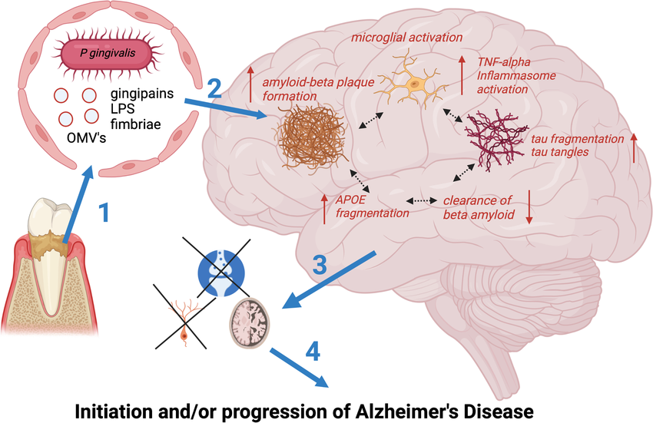
What is Gingipains enzyme?
The role of this enzyme is bacterial housekeeping and infection.
Gingipains also digests tau.
Gingipains are associated with the development of periodontitis.

Slide 8
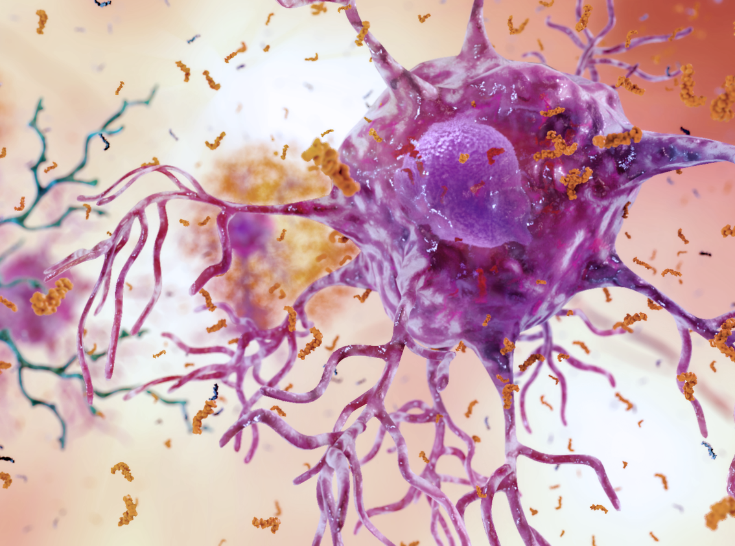
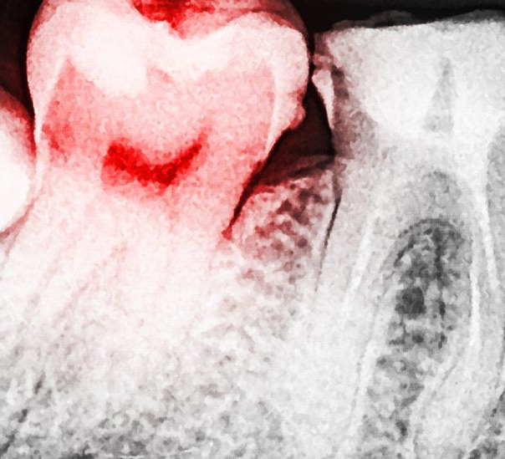
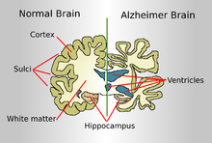
How does Gum disease relate to Alzheimer's
Tau can create neurofibrillary tangles which are abnormal accumulations that can collect inside the brain.
When Tau meets a gingipains enzyme, these ultimately kill neurons
When the nerve cell dies and the free tau protein leaks into the brain, the tau may attach itself to healthy neighbouring nerve cells.
The process repeats itself leading to further damage of the brain and the disease in time spreads.

Slide 9
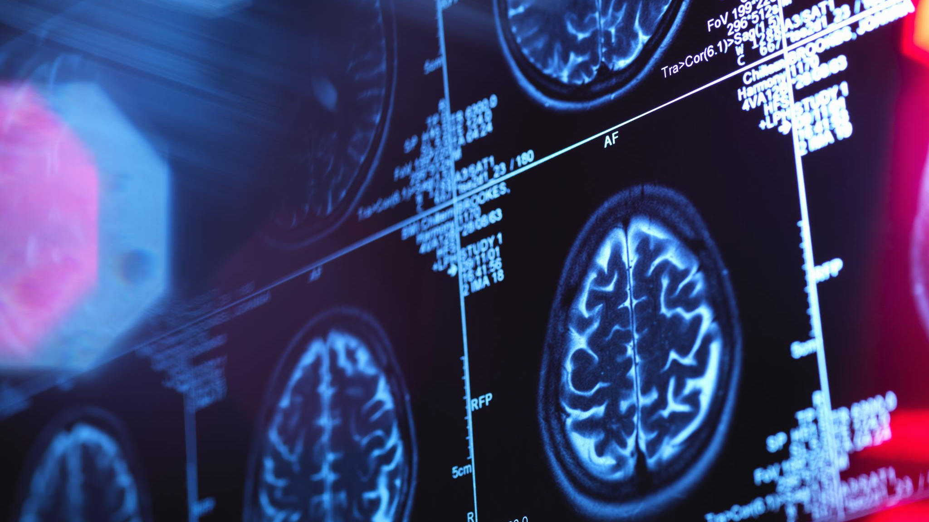
Can Gum disease be a cause of Alzheimer’s?
What do you think?

Slide 10
The answer is YES! Gum disease can be a contribution to Alzheimer’s.
The gingipain’s enzyme, released by the plaque in periodontitis can contribute to the formation of neurofibrillary lesions and tangles, which form on the brains of those suffering from Alzheimer’s.
References:
3/3/24 12:58 https://www.nhs.uk/conditions/gum-disease/
3/3/24 13:03 https://www.bbc.com/future/article/20220707-why-bad-teeth-are-harmful-to-your-health
3/3/24 13:18https://www.google.com/url?sa=t&rct=j&q=&esrc=s&source=web&cd=&cad=rja&uact=8&ved=2ahUKEwjghLeqstOEAxUD7QIHHaliB-gQFnoECBUQAw&url=https%3A%2F%2Fwww.alz.org%2Fco%2Fnews%2Foral-health-and-alzheimers-risk%23%3A~%3Atext%3DThe%2520analysis%2520revealed%2520that%2520older%2Cpreceded%2520the%2520diagnosis%2520of%2520dementia.&usg=AOvVaw3FngzJRW_ptiRLMRyuDfRu&opi=89978449
3/3/24 14:16 https://www.newscientist.com/article/2191842-gum-disease-may-be-the- cause-of-alzheimers-heres-how-to-avoid-it/
4/3/24 18:02 https://www.nhs.uk/conditions/gum-disease/
4/3/24 18:12 https://www.bbc.com/future/article/20220707-why-bad-teeth-are-harmful-to-your-health
4/3/24 18:58 https://www.bbc.com/future/article/20220707-why-bad-teeth-are-harmful-to-your-health
5/3/24 15:00 https://www.alz.org/alzheimers-dementia/what-is-alzheimers
5/3/24 15:34 https://www.google.com/url?sa=t&rct=j&q=&esrc=s&source=web&cd=&cad=rja&uact=8&ved=2ahUKEwjEkrff9dWEAxWOGhAIHfdUBCcQFnoECA4QAw&url=https%3A%2F%2Fwww.alz.org%2Fmedia%2Fdocuments%2Falzheimers-dementia-tau-ts.pdf&usg=AOvVaw3swk7kdS8-0rl9Xe_0x4we&

