Slide 2
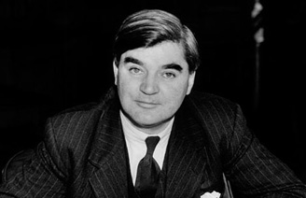
History of the NHS
The NHS was created out of the ideal that good healthcare should be available to all, regardless of wealth. When it was launched by the then minister of health for the Labour party, Aneurin Bevan, on July 5 1948, it was based on three core principles:
that it meet the needs of everyone
that it be free at the point of delivery
that it be based on clinical need, not ability to pay
These three principles have guided the development of the NHS over more than 60 years and remain at its core. In March 2011, the Department of Health published the NHS Constitution.

Slide 3
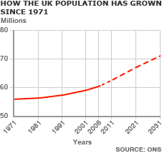
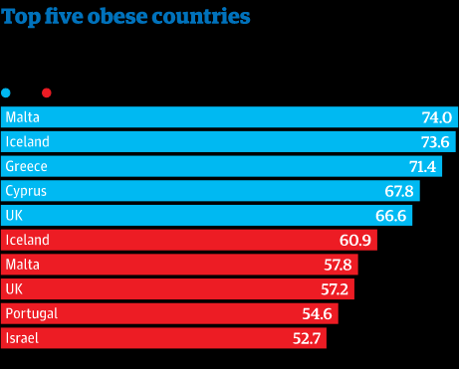
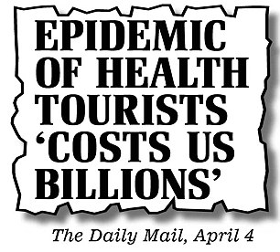
Problems with the NHS
An ageing population/growing population.
Evolving healthcare needs, such as the increase in cases of obesity.
Health tourism.

Slide 4
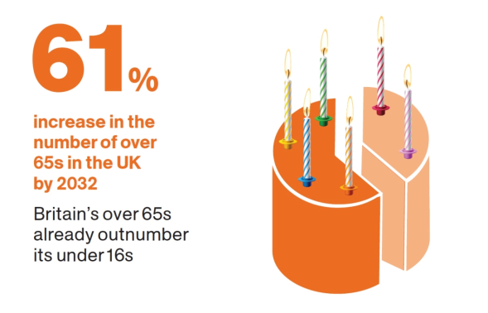
An ageing population/growing population
Our population currently has more than three million people aged over 80 years old. By 2030, this figure is projected to almost double, and by 2050 reach eight million. Today one-in-six of the population is aged 65 and over, and by 2050 it will be one-in-four.
Hospital care for the average 89-year-old man costs the National Health Service nine times more each year than for the average 50-year-old man — and 18 times more than for the average 30-year-old man.
Spending is higher for older people both because they go to hospital more often and, when they are there, they receive more expensive treatments.
As the UK population ages, we will need to devote an increasing fraction of our GDP to paying for this — that is, if we want to continue providing the same quality and quantity of healthcare free at the point of use. This would be nothing new: public spending on healthcare has been growing steadily as a share of GDP since the early 1950s. In 1953-54, 2.9 per cent of UK GDP was spent on public healthcare. In 2014-15, we spent more than double that: 7.4 per cent of GDP.
But in past decades the growth in health spending has been offset by falls in other areas of spending. For example, defence spending fell sharply in the 1950s and 1960s, spending on transport and education fell in the 1980s, and the past 10 years has seen a fall in spending on policing. Looking forward, it is harder to see which areas of spending can now be cut.
That means we might have to decide whether to pay more in tax to allow for more spending, or whether to accept that the NHS may no longer offer the same range and quality of services free at the point of use.

Slide 5
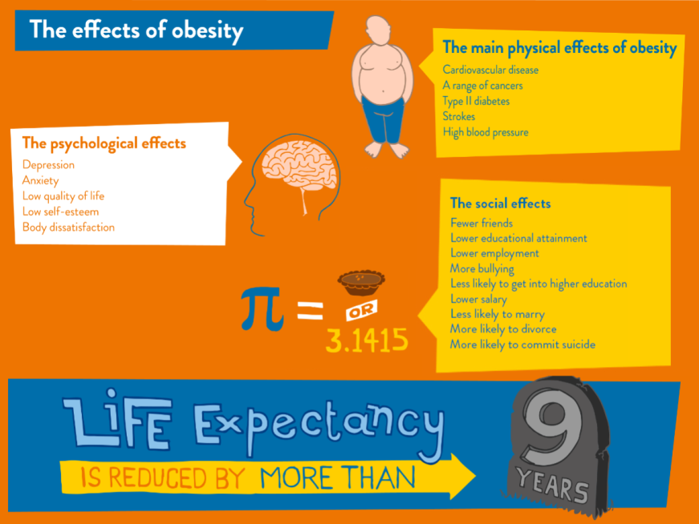
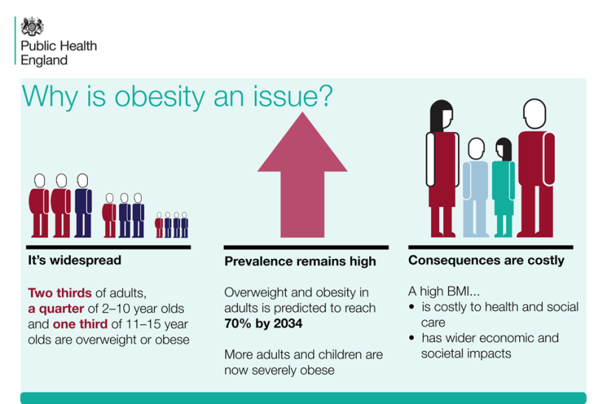
Britain: 'the fat man of Europe'
“Obesity drives disease. It increases the risk of cancer, diabetes and heart disease—and it costs our economy £27 billion a year.”
George Osborne, 16 March 2016
Being overweight or obese increases the risk of a many serious illnesses, such as type 2 diabetes, high blood pressure, heart disease, stroke, as well as cancer.
NHS England said around £16 billion a year is spent on the direct medical costs of diabetes and conditions related to being overweight or obese. They added that the fire and police services cost the British tax payer £13.6 billion each year.
European countries | Percentage of population Obese
UK | 24.9%
Ireland | 24.5%
Spain | 24.1%
Portugal | 21.6%
Germany | 21.3%

Slide 6
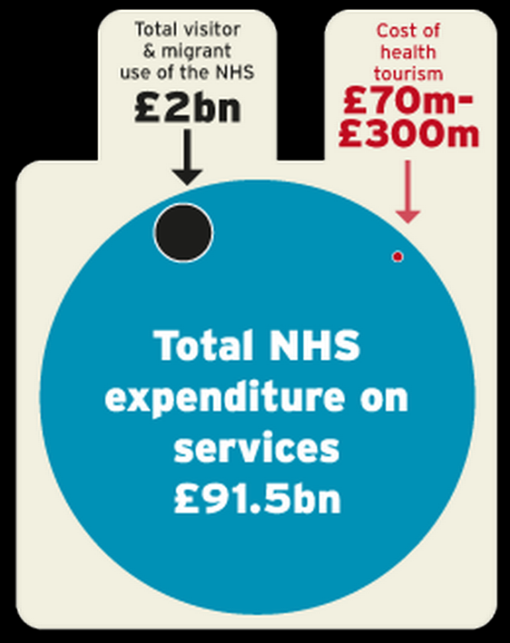
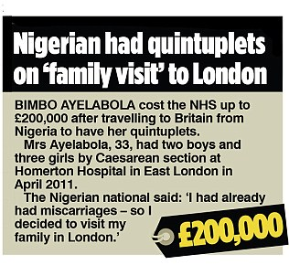
Health tourism
“The creaking NHS crisis could be solved if overseas patients were ordered to hand over cash.”
A former leading cancer surgeon, Professor J Meirion Thomas
Definition: the practice of travelling abroad in order to receive medical treatment.
Whitehall research puts the cost to taxpayers of health tourism at anywhere between £200million and £2billion a year.
Examples:
Luton and Dunstable University Hospital is said to be chasing payment for the caesarean section the unidentified woman had, followed by intensive care treatment for the two babies. The woman gave birth in 2015, and the hospital confirmed it was still owed £348,683 for the treatment. The hospital, which has one of just three paediatric intensive care units in the East of England region, said it could not refuse treatment if there was a "danger to life".
There were 13,077 overseas patients given treatment in the UK in 2015-16, according to data from the 90 hospitals who responded to the freedom of information requests. Of those, over 3,000 were mothers who arrived in the country to give birth.
These funds could be spent on trying to lift the 1% public sector pay cap/ investment into mental health/ trying to resolve homelessness problem (240,000 people).
http://www.dailymail.co.uk/news/article-4186478/Health-tourism-admits.html

