Slide 1
Emergency Medicine

Slide 2
What is Emergency Medicine ?
Accident and Emergency Medicine
Involves the care of unscheduled patients with illnesses or injuries requiring immediate medical intervention.

Slide 3
Attendance & Admissions
-in 2016 there were 23.57 million attendances at England’s A&E departments, of which 65% were at major emergency departments (‘type 1’) which operate a consultant-led 24 hour service. The remainder were at minor injury units, walk-in centres, and single speciality facilities.
-Total attendance increased by 5.2% compared with 2015 – equivalent to an average of 3,216 more people attending A&E each day. Attendance at A&E appears to be increasing at a faster rate than population growth.

Slide 4
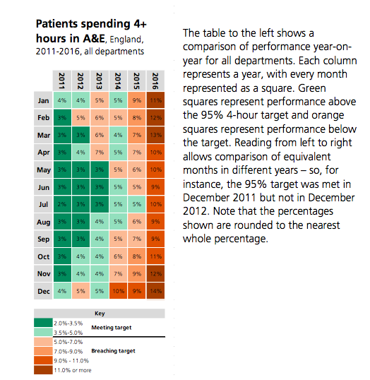
A and E Targets

Slide 5
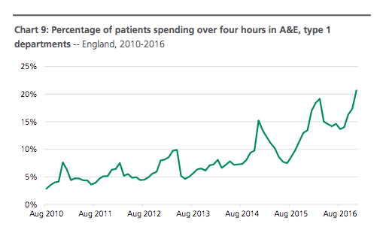

Slide 6
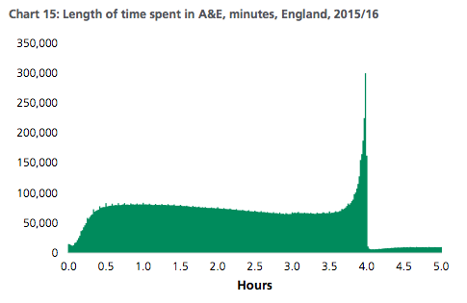

Slide 7
Triage
National Codes:
Immediate resuscitation.
Patients in need of immediate treatment for preservation of life.
2 Very urgent.
Seriously ill or injured patients whose lives are not in immediate danger.
Urgent.
Patients with serious problems, but apparently stable condition.
4 Standard.
Standard A&E cases without immediate danger or distress.
Non-urgent.
Patients whose conditions are not true accidents or emergencies.

Slide 8
What Requires Immediate Intervention?
breathing difficulties-Asthma attack, Pneumonia, Emphysema, Trauma, Atrial fibrillation, Heart failure, Anaphylaxis, Blockage
Persistent severe chest pain-Heart attack, Aortic Dissection and pulmonary Embolism
- Severe bleeding
Severe allergic reactions
Severe Burns
Fits (that won’t stop)- Any type of brain injury such as Trauma, Stroke, Infection or a Brain Tumor
Breaks/Sprains
Severe Intoxication- alcohol, drugs
Trauma
Fever
hypoxia

Slide 9
ABC
-When assessing emergency patients, ABC can be used to prioritise what needs to be reviewed most urgently.
A- Airway
B- Breathing
C- Circulation

Slide 10
Trauma Team
https://youtu.be/QMbeQK758fA

Slide 11
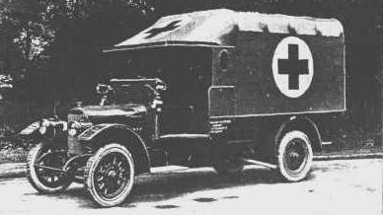
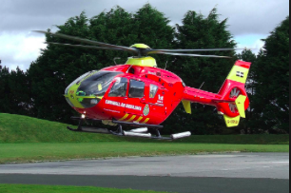
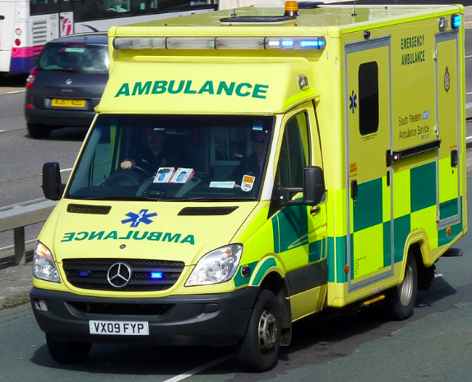
Modern Capabilities of Emergency Medicine

Slide 12
Helicopters and Modern Ambulances
-With the use of modern transport, the time taken for patients to receive medical treatment has rapidly decreased over the last 100 years.
-Due to this, the survival rates of trauma patients have improved dramatically and the chance of irreversible damage decreased.
-The quicker treatment is received, the better the outcome for the patient.

Slide 13
London’s Air Ambulance
https://www.youtube.com/watch?v=Hq5VVuJVTBA

Slide 14
Thoracotomy
Advancements in Emergency Medicine now mean we can perform open heart surgery by the side of a road. This procedure is known as thoracotomy and was first used outside of hospital by London’s air ambulance team and involves opening the chest in order to access the heart. They most commonly use the procedure to resuscitate stabbing and shooting victims. The procedure is preformed on average 8 times a month.
The patient is intubated and the chest opened, any lacerations of major arteries can be sutured and the heart can be manually massaged until defibrillation can occur.

Slide 15
London’s Air Ambulance
The world’s first pre- hospital REBOA was carried out by London’s air ambulance in 2014. This is a pioneering new technique to prevent trauma patients bleeding to death. It is a procedure used to control severe pelvic hemorrhage, an injury most commonly associated with cycling incidents and falls from heights. The procedure took 2 years to develop by The Royal London Hospital.
http://www.bbc.co.uk/news/health-27868418

Slide 16
NHS Tracker
http://www.bbc.co.uk/news/health-41483322
King David High School: M8 5DY

