Slide 1
Engaging with Super-Curricular Content

Slide 2
Decisions:
Choose a course
Choose a college
Send us Additional Information:
Fill in your SAQ
Register for any Pre-Interview Assessments
Send us any Written work, ECFs where applicable
Invited to Interview?
Interviews usually held early-mid December
You may take an At-Interview Assessment
Receive offer or rejection from chosen college.
Or, you may be ‘Pooled’ and be made an offer by another college.
Meet or miss your offer on Results Day, and confirm your place if successful.
Process Complete! ☺
Apply through UCAS
Cambridge is just one of your 5 University choices
Sit your Pre-Interview Assessment, if applicable
Can usually be taken in your school
The Application Process
Early Deadline!
Submit by 15th October
Notes:
For those that don’t know: Cambridge is one university and teaching is standardised, uni is broken down into different Colleges. This doesn’t affect chances of getting in, but about choosing the kind of place you want to live and community you want to be a part of. Can do research on this but shouldn’t be a major consideration
Not going to go through everything, just highlight important things that you should know and be thinking about

Slide 3
How is your Application Assessed?
Cambridge assesses applications holistically.
This means that we take the following information:
Prior academic achievement
Predicted grades
Personal statement
School reference
Admissions assessments
Written work
Interview performance
And use it to build up an “academic picture” of the applicant.
All of this information is then viewed in context.

Slide 4
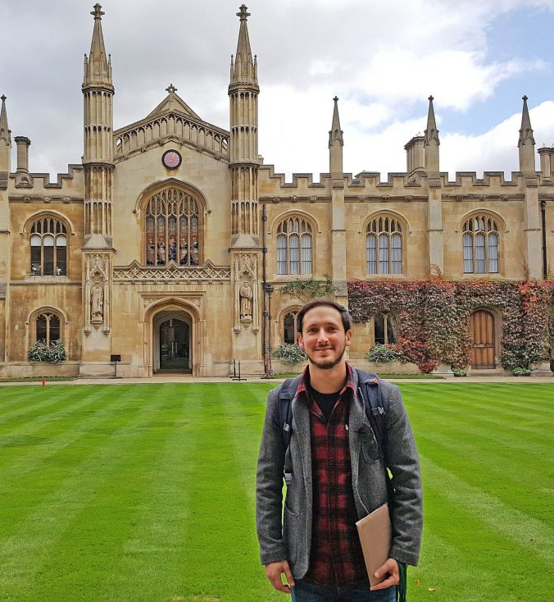
What are we looking for?
Applicants who would benefit the most from what we have to offer, irrespective of background.
Are academically able, self-motivated and independent hard-workers.
Have the right combination of subjects for their chosen course.
Have engaged with their chosen subject(s) enthusiastically outside school.
Are predicted at least:
A*AA (Arts) or A*A*A (Sciences) at A-Level (Cambridge).
AAA to A*A*A depending on course applied for (Oxford).
Notes:
Winter pool is system for ensuring that where you apply doesn’t affect your chances of getting into Cambridge as a whole. System for redistributing students from oversubscribed Colleges.

Slide 5
“Super-Curricular”
Super-curricular: Academic engagement that goes beyond the school curriculum in terms of both its content and conceptual sophistication.
Extra-curricular: Engagement that has little academic relevance but contributes to the “well-roundedness” of a student.
Cambridge is interested in super-curricular engagement.

Slide 6
How am I taught?
Standard features:
Lectures
Seminars
Labs
Independent study
Special features
Supervisions
Due to this: more focus on independent study
8 week terms
(Aspects of) the academic community

Slide 7
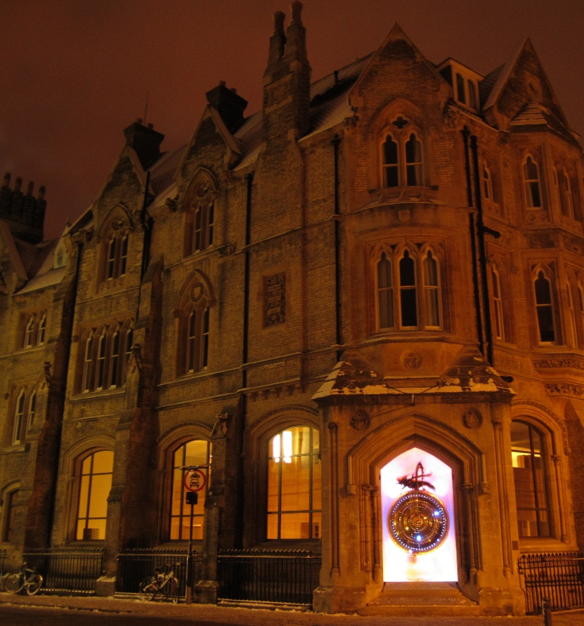
Supervisions
Typically one-to-one or two-to-one.
Based on an assignment (such as a problem sheet or essay).
Assignments are completed independently using libraries and other resources (although assistance is available).
You typically have a week to complete the assignment.
A supervision is likely to cover a topic from a specific paper.

Slide 8
Supervisions
Independently studying for the assignment will comprise the majority of your week.
Receive extensive written feedback on assignment.
You will discuss the assignment with your supervisor for at least an hour.
Chance to ask questions and discuss topic.
Supervisions can be used as a basis for further study.
Expect at least one supervision a week.
Significant and rapid academic development through supervisions
Assignment
Independent study
Supervision and feedback

Slide 9
Choosing a Course
Most important step for ALL your applications – you need to choose a subject you love and will do well at!
Look up specific courses – courses are not the same at all universities.
E.g. Politics is encompassed by Human, Social, and Political Sciences at Cambridge, Chemistry by Natural Sciences.
Others e.g. Anglo-Saxon, Norse and Celtic Studies are unique.
Start thinking about this early (now!)
This gives you time to read around your subject, engage in ‘Super-Curricular Activities’ and get a sense of your interests.
This is important preparation for writing your Personal Statement and for Interview.
It also ensures you’ve made the right decision about your subject choice – if you find reading more about your course boring, it might not be for you!
Remember: All Cambridge degrees offer great career prospects: choose what you love, not what your parents or friends think will get you a good job!

Slide 10
Personal statement
What is the personal statement?
A piece of writing (no more than 4,000 characters) outlining why you want to study your course at University.
What should I include in my personal statement?
80% of the personal statement should be academic-related.
Focus on “super-curricular” activities.
Reflect on how you have pursued your subject beyond the school curriculum.
Don’t just list what you’ve read, explain why you found it interesting.
Notes:
College choice: choosing where you want to live, not an academic consideration (can look up in own time)

Slide 11
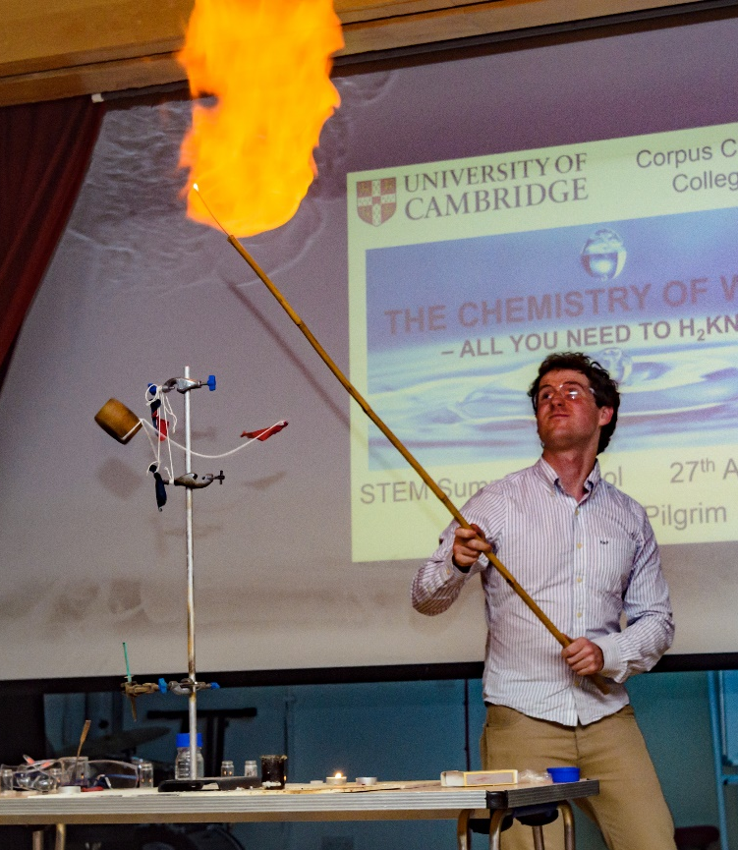
The wide scope of “super-curricular”
The scope of super-curricular activities goes far beyond reading books. Ensure that you do yourself justice. Here are a few super-curricular activities:
Further reading.
Online lectures and podcasts.
Blog entries.
Reading groups (with classmates).
Learning and practicing mathematics (STEM subjects).
Novels (not just for English).

Slide 12
The wide scope of “super-curricular”
Entering academic competitions.
Online courses.
Encyclopedia articles and magazines.
Resources from the Undergraduate course (course outlines, reading lists, lecture slides).
Writing (blogs, essays, musings etc.).
Applying relevant skills to tangential topics/content.

Slide 13
Further Reading
Make sure that you enjoy what you read and that it is relevant to your course!
Less is more:
Don’t plough through Karl Marx’s Capital only to not understand half of it.
Reading extracts of books or secondary literature (such as articles or introductory books) looks far more impressive.
Notes:
College choice: choosing where you want to live, not an academic consideration (can look up in own time)

Slide 14
Further Reading
What should I read?
Take a topic you’ve enjoyed at school and read beyond the curriculum.
A topic you independently find interesting.
A completely new topic.
A topic from your University course's reading list.
Notes:
College choice: choosing where you want to live, not an academic consideration (can look up in own time)

Slide 15
Learning and Practicing Mathematics
STEM subjects and economics.
Learn and practice super-curricular mathematics.
Don’t just read popular non-fiction books.
Admissions tutors want to see that you are enthusiastic about and can handle the mathematical side of the course.
Notes:
College choice: choosing where you want to live, not an academic consideration (can look up in own time)

Slide 16
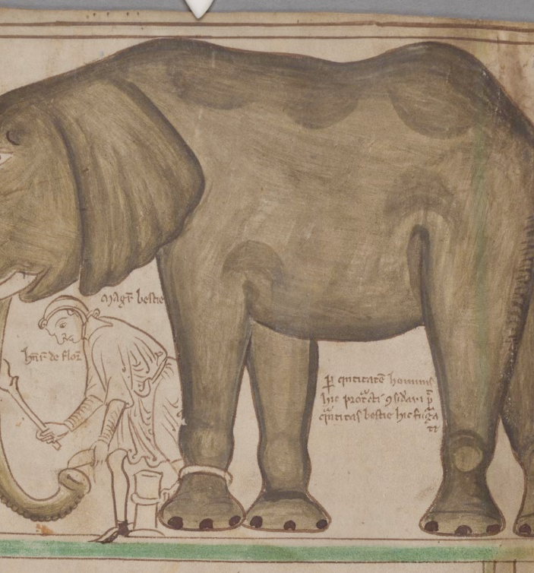
Linking up with A Levels
You can use your A Levels as a base for super-curricular study:
Selecting an interesting topic from the syllabus.
Thinking about A Levels (e.g. “how do explanations differ in maths, biology and history?”).
Connecting A Level topics to entirely new topics.
Tip: Take an A Level topic that really interests you and read the Very Short Introduction to that topic or read the SEP entry (applies to STEM as well).

Slide 17
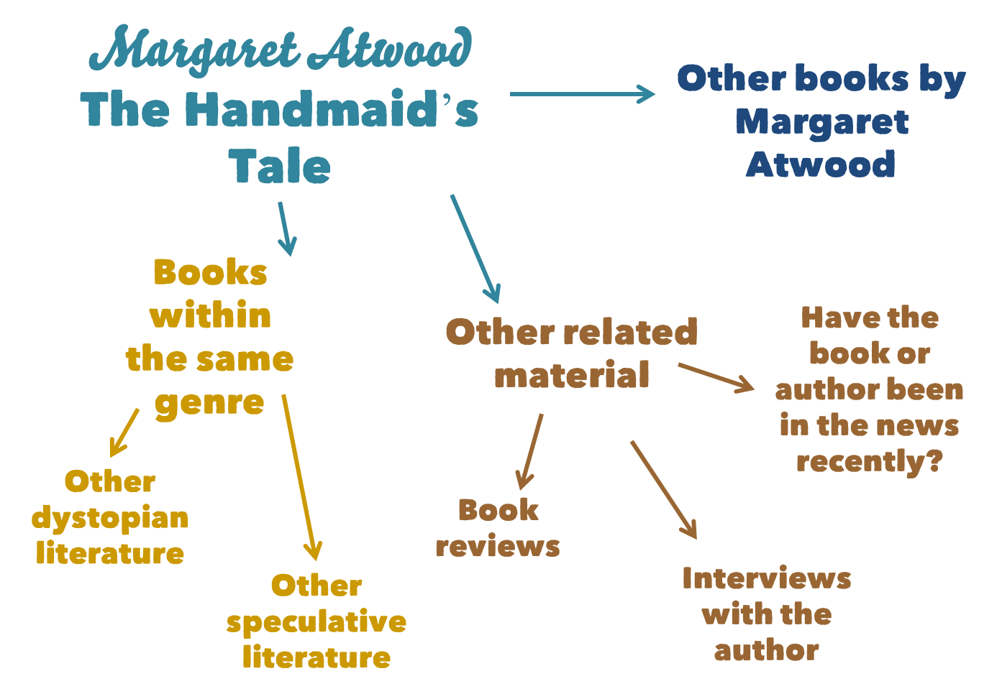
Notes:
College choice: choosing where you want to live, not an academic consideration (can look up in own time)

Slide 18
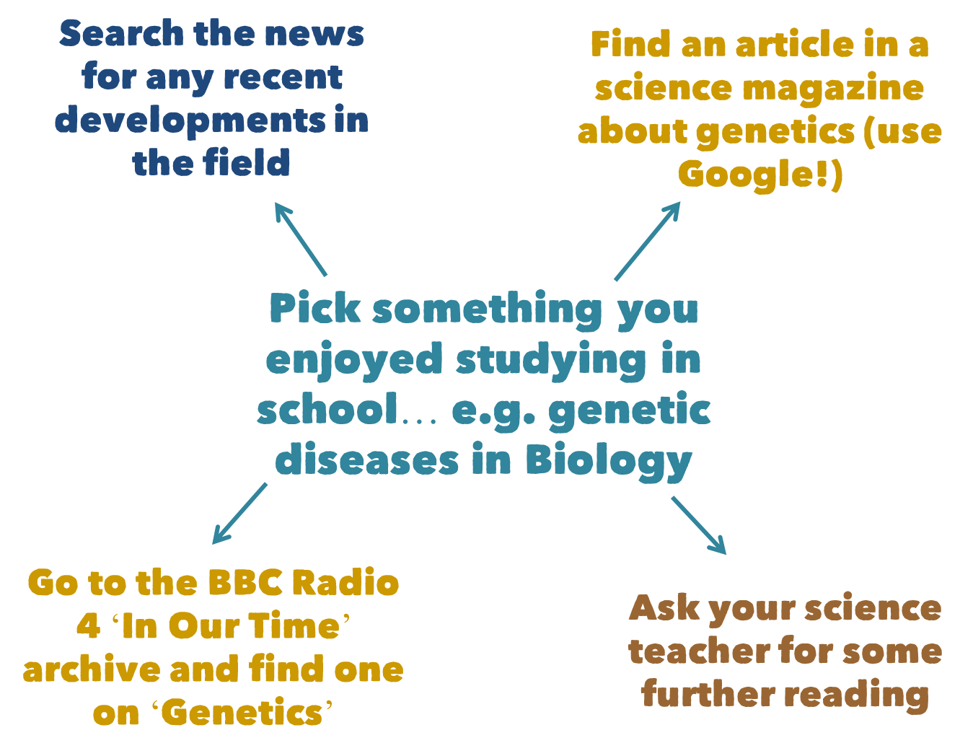
Notes:
College choice: choosing where you want to live, not an academic consideration (can look up in own time)

Slide 19
Locating open access resources
Some suggestions:
Google: key terms, “best archives for subject x”, “ text y pdf”.
Wikipedia: although you’re often told not to use it, Wikipedia can be a great starting point (although use with caution). Moreover, the references are often open access.
University resources: preliminary reading lists, undergraduate reading lists, lecture slides/handouts, university archives.
Archives: e.g. Elsevier, PhilPapers, Open Library. (Most of the online archives will have an open access section. A lot of academic journals do too – even if they're mostly pay walled).
Magazines: You can often get several free articles before getting a subscription.
Online courses: e.g. Coursera, Edx.
Social Media: Facebook or Twitter pages of academic journals or societies.
Stanford Encyclopedia of Philosophy.
Isaac Physics, Isaac Chemistry.
Notes:
Explain what open access is.

Slide 20
Locating Open Access Resources
Open Access Databases
arXiv: All Sciences
bioRxiv: Life Sciences
Wikiwand: List of Open Access Journals
SocArXiv: Social Sciences
Australian Policy Online
Social Science Research Network
Those in bold are probably the best.

Slide 21
Journal (essentially a blog) looking at technical skills in the context of History.
“Extracting Illustrated Pages from Digital Libraries with Python”.
“Introduction to the Bash Command Line” (Supplementary).
The Programming Historian

Slide 22
Article in Ecography, “Mechanistic insights into the role of large carnivores for ecosystem structure and functioning”
Abstract, introduction and discussion.
Slightly more technical: methods and results.
Point of technical interest: The Madingley Model.
The model has its own website (with useful information), you can even download the code to run the model yourself!
Ecography

Slide 23
“An Essentialist Theory of the Meaning of Slurs”.
Something like this might prove too complicated (or not!).
When material is inaccessible, it can still be a good platform for further reading.
Philosopher’s Imprint

Slide 24
Any Questions?
Email me: wm287@corpus.cam.ac.uk

