Slide 1
Interventional radiology and angiography

Slide 2
What is interventional radiology?
Interventional radiology is a branch of radiology which involves minimally invasive procedures preformed under x-ray image guidance.
The images are produced using a remote controlled fluoroscopy machine – this uses x-rays to produce real time moving images of the interior of an object.
This area of medicine has expanded to play a vital role in both elective and emergency treatment.
There is a significant shortage of intervention radiologists in the UK – 45% of health services in England do on offer such procedures
To practice as an interventional radiologist, a doctor must specialize as a radiologist then complete additional specialist training in the practical elements of interventional radiology

Slide 3
Uses of interventional radiology:
Stent replacement
Embolization
Thrombolysis
Balloon angioplasty
Atherectomy
Electronphysiology
Abscess drainage
Biopsy
The most frequent Interventional radiology procedure undertaken as an emergency are arterial embolization – to relieve obstructed kidneys and avoid renal failure

Slide 4
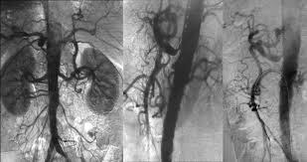
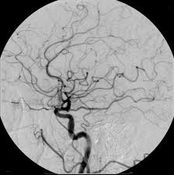
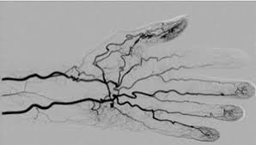
What is angiography?
It is the radiological examination of vessels after introduction of a contrast medium.
The contrast medium was initially ionic iodine compounds
Now non ionic compounds are used – less likely to have an adverse reaction
Angiographic imaging equipment cost £300,000.00 each.

Slide 5
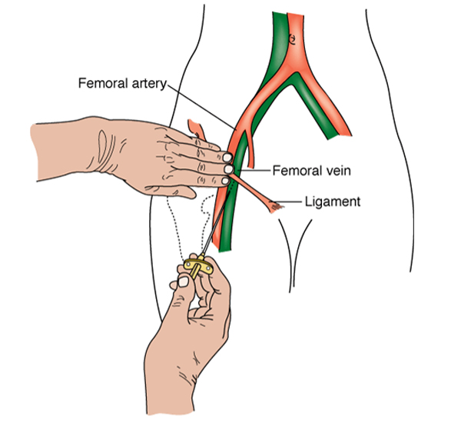
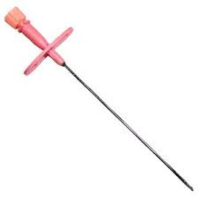
Basic procedure principles
Arterial access is gained most commonly through the femoral artery using a ultra sound machine
(this is done through the Seldinger technique – a Seldinger needle is used which has a solid inner needle and an outer thin wall needle for smooth passage)
The site of passage is cleaned, area is draped and local anesthetic is inserted.
The Seldinger needle is inserted into the artery
a guide wire is inserted into the needle. Once the guide wire is in place the needle is removed
A catheter is then threaded into the guide wire
The catheter is then put in place and the guide wire is removed. The contrast is released through the catheter and images are taken.

Slide 6
leeds interventional radiology department
https://www.youtube.com/watch?v=w0EQQzIwk-E

Slide 7
Advantages of interventional radiology
The patient has a pain free procedure making their experience more pleasant
Life threatening conditions are treated much less invasively then ever before e.g. stroke, cancer, cardiovascular disease
This leads to a much shorter recovery time and reduces risks of infection from large wound post opp.
With the use of interventional radiology there is a shift in care to less expensive outpatient settings, as 80% of procedures the patient can be home on the same day.

Slide 8
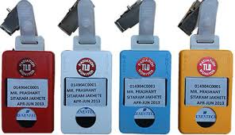
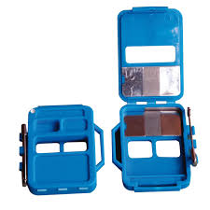
disadvantages
Since an interventional radiology procedure requires a radiation dosage effecting both the patient and operators
Radiation dose is affected by the complexity of the procedure
the patient and operator must both monitored
Traditionally done using TLDs (thermo luminescent dosimeter) or film badges to monitor radiation dose exposure.
Whilst radiation is a great disadvantage, overall the advantages of the minimalism of interventional radiology procedures taking the place of invasive operation over compensates for the radiation.

