Slide 1
Notes:
Hi I’m Aviva and I work for the charity Jnetics, from our manchester office.
Have any of you heard of us before?
If not- can you guess what we might focus on from our name/logo?
Allow them to guess
Feel free to stop me for Qs and also will have time at the end…

Slide 2
Only UK- based charity devoted to raising awareness of and preventing Jewish genetic disorders (JGDs)
Notes:
So we are the only uk charity….
We raise awareness of JGDs via community education and we also work hard trying to prevent certain very severe JGDs occuring in our community- and I’m going to go on to describe how we do that
For now- i have a question- can any of you give me a one word definition of what JGDs are?

Slide 3
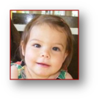
JGDs
Genetic disorders that are more prevalent
amongst those of Jewish origin
compared to the general population
Not just Jewish
Phenomenon exists in all ethnic groups
Ancestry not observance
30+ disorders - varied
Notes:
So the correct definition of JGDs is as follows- genetic disorders that are more prevalent amongst those of Jewish origin compared to the general population
There are a few things about JGDs that I want to clarify
The first is that these disorders are not just Jewish disorders. They do occurs in the general population/people with no Jewish ancestry. The key is that they are more common amongst Jewish people when compared to the general population
The second is that this phenomenon occurs in all ethnic groups. Is there anything you notice that is weird about the lower image? This is actually a genetic condition called polydactyly and is more common amongst people of African origin.
The third important point is that the risk of these genetic disorders applies across all people with Jewish ancestry, and this has nothing to do with how observant they are of how affiliated with the community they are. there is the same increased risk amongst people who have no interest in Jewish life and there is amongst chasidim/ultra orthodox. – to illustrate this- the picture above is a little girl called Ameile Lewi…
There are actually a group of over 30 JGDs and they vary a lot- some are mild while some are severe, some are inherited in a recessive way and some dominantly, some treatable and some not, some are sephardi and some ashkenazi----just to point out that for the rest of the presentation when I refer to JGDs im really referring to ones with AJ relevancec. Jnetics doesn’t at the moment offer screening for the sephardi disorders.
We are going to focus on a group of the JGDs known as the severe recessive JGDs

Slide 4
Tay Sachs Disease
Cystic Fibrosis
Glycogen Storage Disorder (type 1a)
Fanconi Anaemia (type C)
Niemann-Pick Disease (type A)
Bloom Syndrome
Familial Dysautonomia
Canavan Disease
Mucolipidosis IV
Severe Recessive JGDs
There are 9 of them
Very debilitating, often life shortening,
no known cure
Occur when an individual has 2 copies of the faulty gene (contrasts dominant disorders)
Inherited one from each parent
e.g. Tay-Sachs disease
Notes:
Lets now focus on the severe recessive JGDs-
Amongst all the 30+ JGDs, research has identified 9 specifically severe recessive JGDs and these are the ones that as charity we are working to prevent.
So all the disorders are severe, and by that we mean they are very debilitating, often life shorening and have no known cure
For example – Tay Sachs Disease ….
And who can tell me what recessive mean?correct, a recessive disorder is one that occurs when an individuals has 2 faulty copeis of the relevant gene. We know that we have 2 copies of every gene, and recessive disorders occur when there are faults in both copies of the relevant gene.
Okay so how does that arise? It happens when a child inherits one faulty copy from each parent. Each parent has a healthy copy and a faulty copy, and both parents pass on their faulty copy ,resulting in a child that has 2 fualty copies and no healthy copies. For a couple like this- this will happen 1 in 4 times….
Does any one know what term could describe the parents? What term described when someone has one faulty copy and one healthy copy of a gene associated with a recessive disorder?

Slide 5
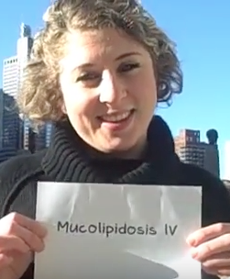
Being a carrier
One copy of faulty gene
Healthy copy compensates
Unaffected- no impact on own health
Increased risk of having an affected child
Only if partner is a carrier of SAME disorder
1 in 4 chance
Notes:
We just used this term ’carrier’ but I want to define it a little more
Being a carrier of a recessive disorders means you have one faulty copy of the relevant gene and one healthy copy
The healthy copy compensates for the faulty copy and the person is totally unaffected by the disorder. The healhy copy is enugh.
Take a look at the picture- she is a carrier of one of the srJGDs and you wouldn’t know. No symptoms, and isnt going to go on the carry symptoms.
The important point about carries is that these are the people that are at increased risk of passing on the condition and having an affected child and this is because if a carrier has children with a carrier of they same disorder, they could both pass on the faulty copy at the same time, which would occur statistically 1 in 4 time, resulting in a child that suffers from the disorder.

Slide 6
Disorder | Carrier Frequency (among Ashkenazi Jews)
Tay Sachs Disease | 1 in 25
Cystic Fibrosis | 1 in 25-29
Familial Dysautonomia | 1 in 30
Canavan Disease | 1 in 40-57
Glycogen Storage Disorder (type 1a) | 1 in 71
Fanconi Anaemia (type C) | 1 in 89
Niemann-Pick Disease (type A) | 1 in 90
Bloom Syndrome | 1 in 100
Mucolipidosis IV | 1 in 100-125
1 in 5
Notes:
This table shows for each of the 9 srJGDs, what the risk is for Ajs of being a carrier.
Okay so now I want you all to guess- how common d you think being a carrier of one of these 9 conditions is?!
1 in 5 people with AJ origin is a carrier of one of the 9 srJGDs.
So if we look at this room- there are about 15 people here- that means 3 of us are at increased risk of having a child with one of these conditions.
That seems really dramatic, but the good new is carriers can entirely avoid having an affected child and this is where carrier screening comes in.

Slide 7
Carrier Screening
Genetic test to see if someone has one copy of the faulty gene
Identifies those at risk of having an affected child- carriers/carrier couples
Using saliva sample
Notes:
So what is carrier screening?
Any one got any ideas? Using these pictures can you guess?
Okay so its very nice that carriers/carrier couples now have the information about that fact that are carriers- but what can they do next?
Do any of you have any ideas?

Slide 8
Options for carrier couples
Egg/sperm donation (via IVF)
Prenatal diagnosis
Pre-implantation genetic diagnosis (PGD)
Notes:
Once carrier couples are aware of their status, there are several options for them to avoid having an affected child…
Talk through them
Can someone read the speech bubble? This really sums up the significance of carrier screening.
So carrier screening is routine internationally- USA, Australia etc. People with AJ origin get screened- normal part of life and its had amazing consequences.

Slide 9
The UK community is far behind
Children are still born with entirely preventable conditions

Slide 10
The Solution
The GENEius programme
Launched Jan 2017
Education and screening programme
For young Jewish adults
Taken to Y12 students in 6 high schools so far
Aims
- Eradicate severe recessive JGDs
- Change mindset
Notes:
Jnetics solution to this problem- the GENEius programme
Launched a year ago, and is an education and screening programme..
Its aimed at young Jewish adults- 3 main groups – Y12, uni, engaged. Atm we have taken it to the Y12 students in 6 Jewish high schools- 700 students.
We have big ambitions for GENEius but they are entirely achievable- eradicate JGDs from UK J community ad to change the mindset of the community so they understand that screening is an indispensable part of Jewish life- something that needs to be done before having children.

Slide 11
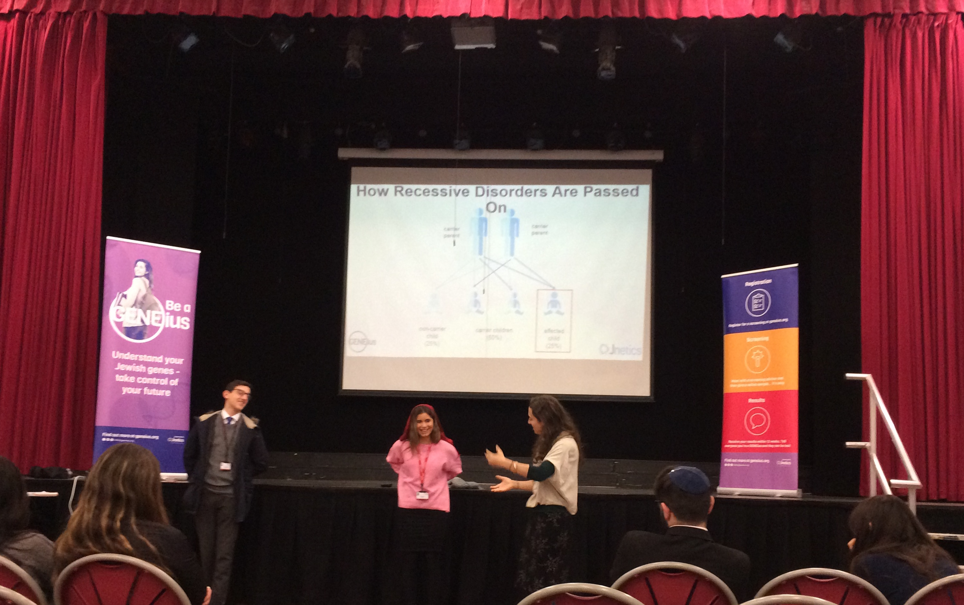
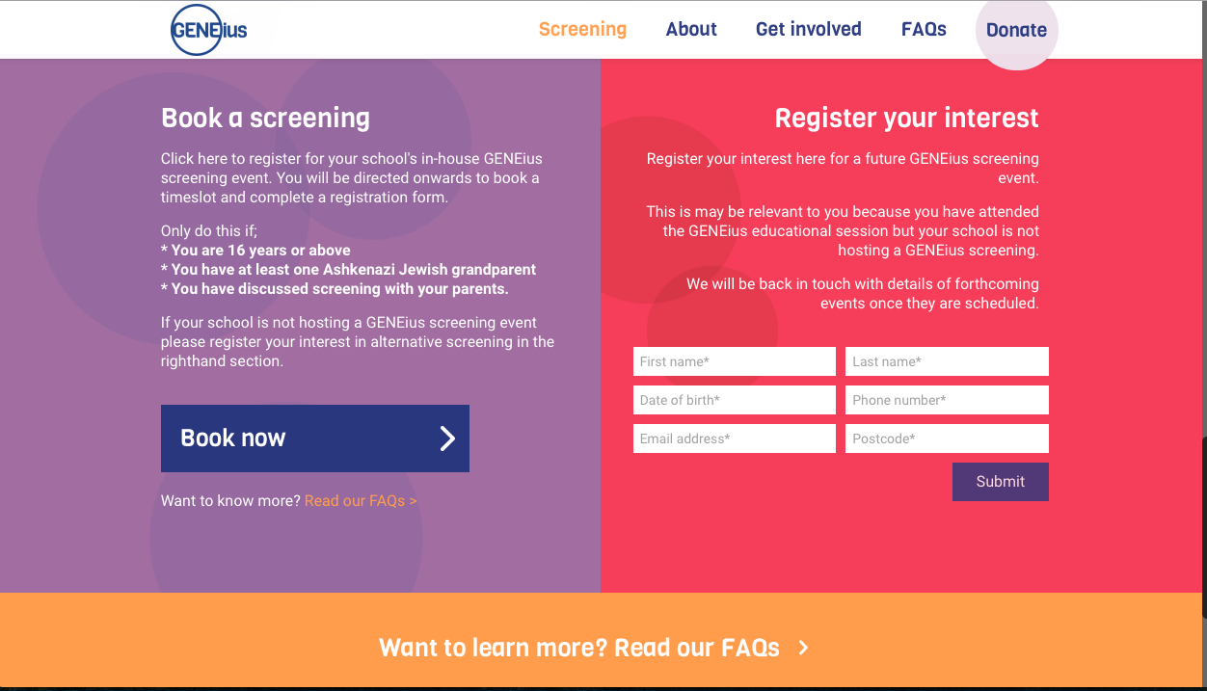
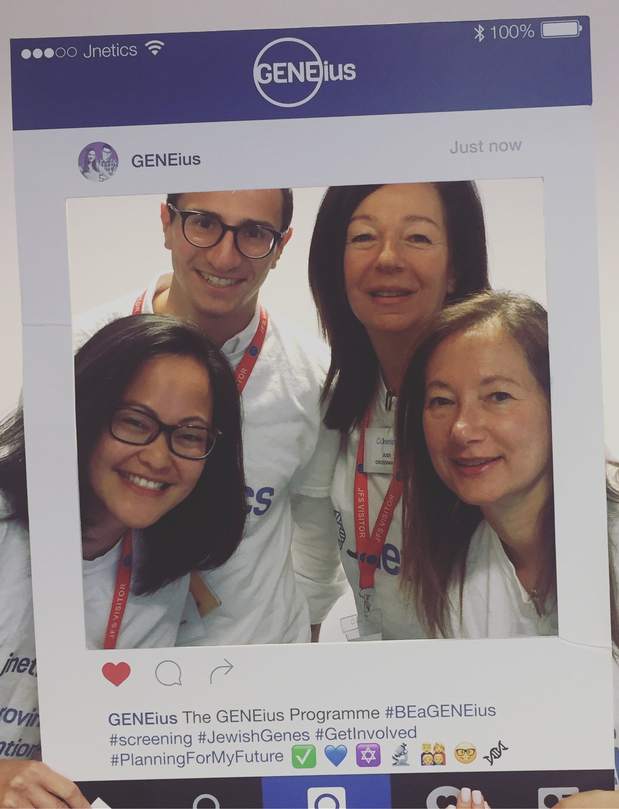
GENEius overview
EDUCATION – JGDs and carrier screening
REGISTRATION- online and with parents
SCREENING- meet advisor + saliva sample
RESULTS – email from genetic counsellor
Notes:
How exactly does the GENEius programme work in schools?
First step is eduaction- so Year 12 student attend an interactive ed session about JGDs in general and about the sr ones and the significance of carrier screening in their prevention
Then if they want they register for the screening event that we run in their school a week or so later- fill out forms and pick a time.
Then they come to the event- first meet with an advisor and then provide their saliva samples
Then results are received 12 week later via email from GC , and phone number is there who feels like they need more info/want to speak to the GC about their results

Slide 12
Education-19th March
Screening- 26th March

Slide 13
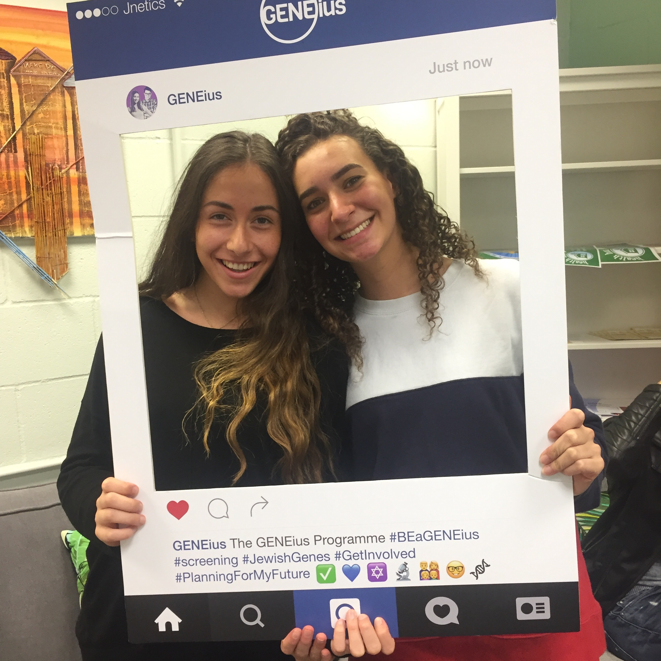
Get Involved?
Get Involved
Be a GENEius ambassador at KD?
- Newsletter?
- Social media?
- Wed 21st/Thurs 22nd March?
Be a GENEius ambassador on campus?
Your input!
Sign up and we will be in touch
Notes:
How can you be involved with Jnetics?
We are always looking for volunteers and especially for young ambassadors
We need young people who understand and are passionate about our cause to help raise awareness and act as advocates. Also its great for you to write about on your CV or talk about at an interview
Whether you are in y12 or y13 we would love you do be ambassadors at KD and help us raise awareness
First opportunity we already have for you- between ES and SS im going to come in at lunch time to help people sign up but really need people like you to help me out, speak to people, they know you so it will be better.
Other than that- do you have any ideas about the engage the students in the programme? Newsletter? Social media? Announcement in assembly?
For the Y13s (or Y12s) we hopefully will be coming to campuses in the near future- you may be there. If you are intersted in getting involved when we do that would be amazing. It always great to have reps/advocates and you will know the students scene bette than we do.
-

Slide 14
Questions?

