Slide 2
Suggested Agenda
Person Centred Care
Health Psychology
Information (as a) Therapy
Some Numbers
Self-Reflection
Care Planning
Goodbye!

Slide 3
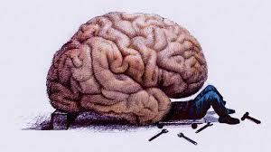
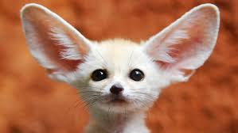
What’s your most important organ?
Ears don’t work without a brain, and don’t hear without a heart

Slide 4
What do you see?

Slide 5
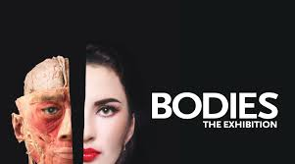

Slide 6
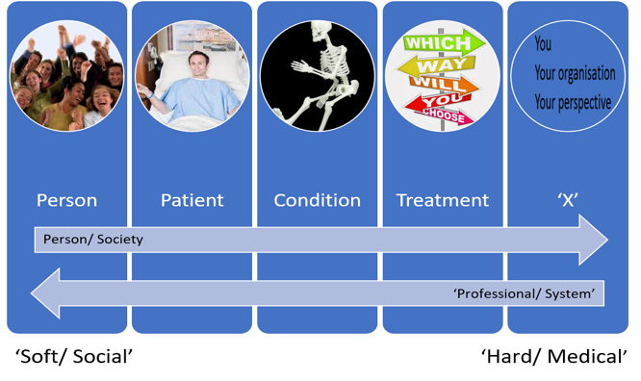
“We see things as we are, not as they are”
Talmud Berachot 55b

Slide 7
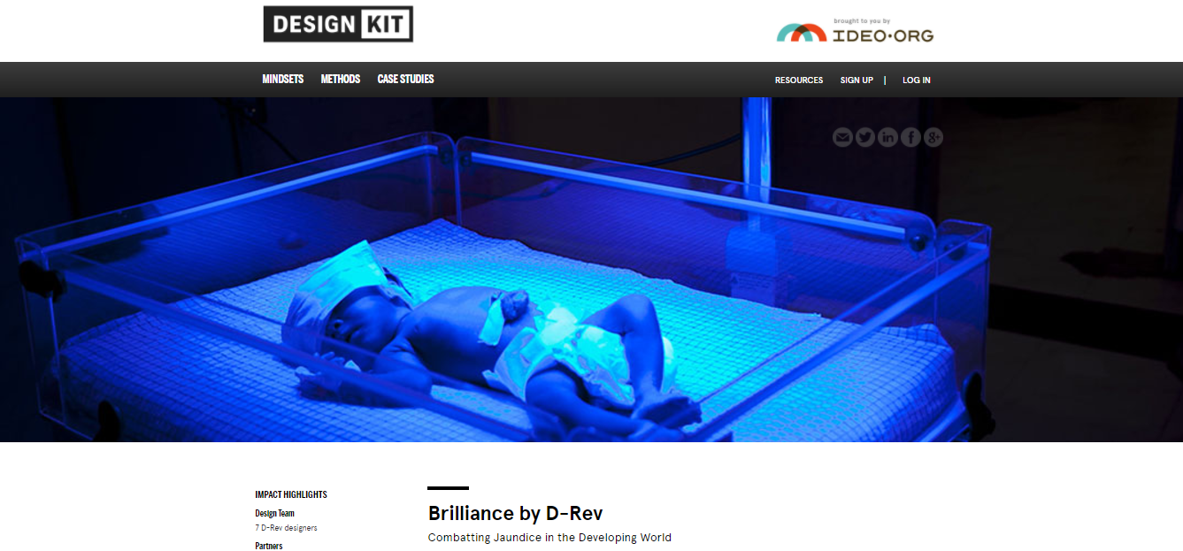
www.designkit.org

Slide 8
Personalised Medicine?
Past Medical History Current Medication
Beyond Health
Ethnicity/ Communication Preferences
Motivation
Health Literacy
“A miracle cure”
Medicines Beliefs
“A poison”
Health Beliefs

Slide 9
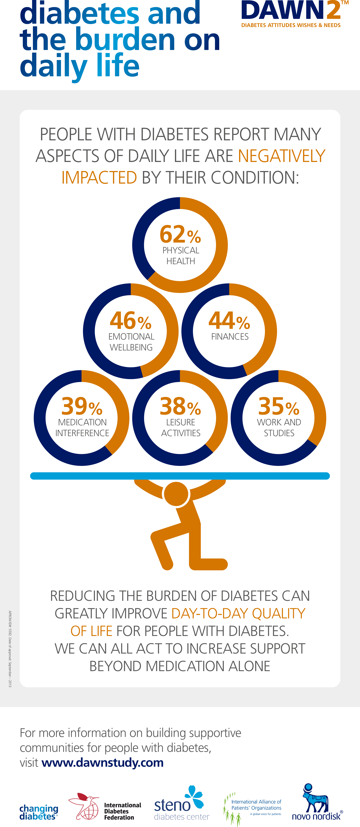
www.dawnstudy.com/dawn2/about-dawn2.html

Slide 10
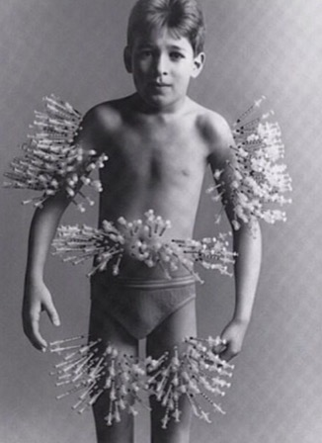
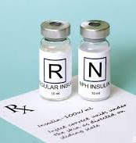
Pharmako (φάρμακο)
Poison
Medicine

Slide 11
“Information (as a) Therapy”
Asset Based Community Development
Care Planning
Health Coaching
Information Prescriptions/ Bibliotherapy
Medicines Optimisation
Patient Activation/ Health Literacy Measure(s)
Patient Decision Aids/Shared Decision Making
Peer Support
Personal Health Budgets/ Support Brokerage
Records Access/ Patient Online
Structured Patient Education
Telehealthcare

Slide 12
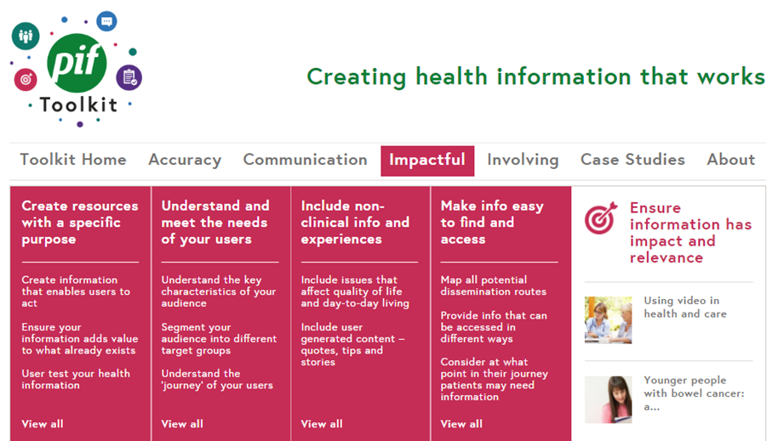
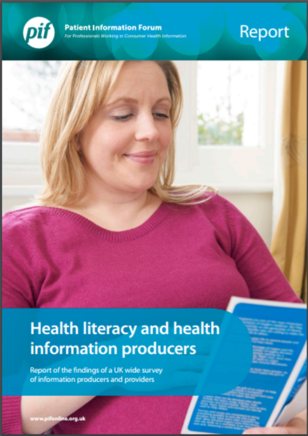
Information Quality & Expertise

Slide 14
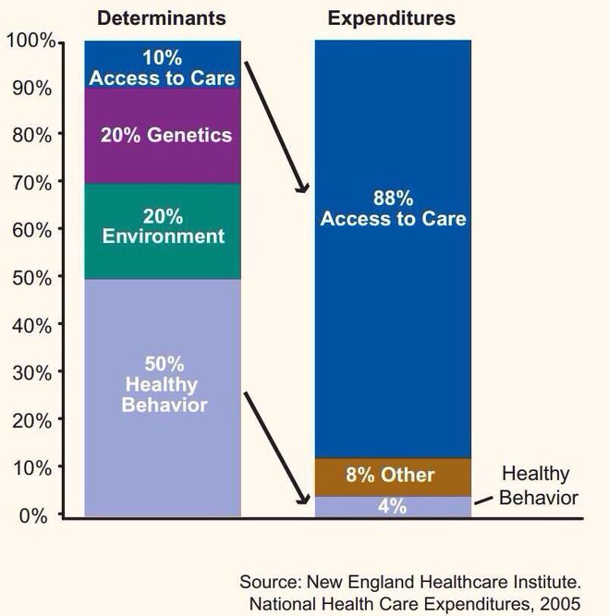
Health Determinants vs. Expenditure

Slide 15
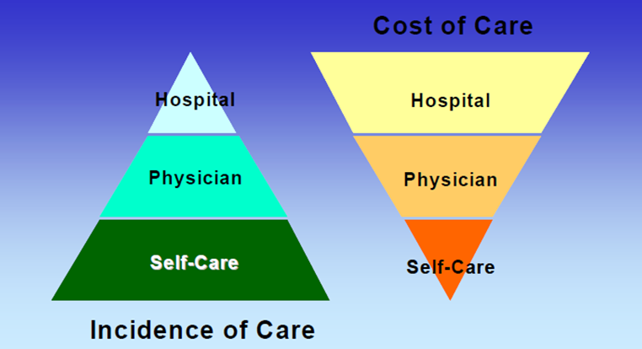
Poll: What is a ‘good’ NHS?
Good NHS = big, local hospital?
Good NHS = an engaged, healthy me

Slide 16
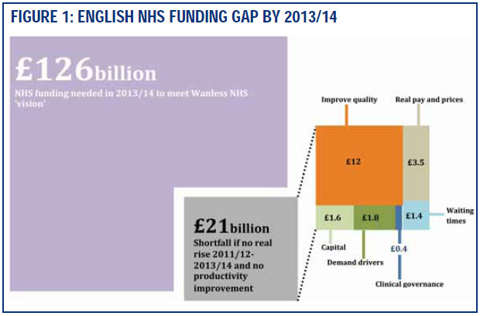
Wanless - Fully engaged public
http://webarchive.nationalarchives.gov.uk/+/www.dh.gov.uk/en/Publichealth/Healthinequalities/Healthinequalitiesguidancepublications/DH_066213

Slide 17
Patient Activation Measure (PAM)

Slide 18
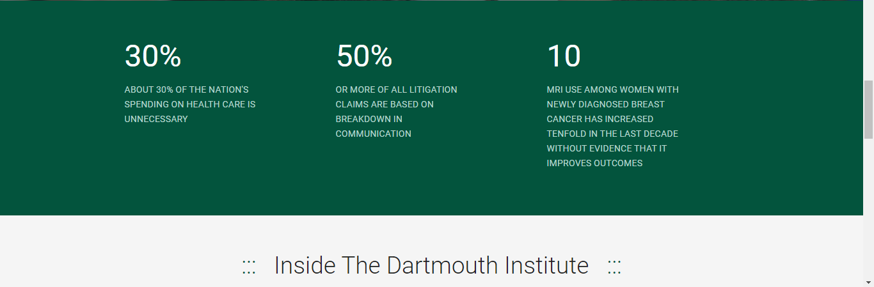
Shared Decision Making/ Unwanted Variation
http://tdi.dartmouth.edu
www.youtube.com/watch?v=hnEIMhwM-OY

Slide 20
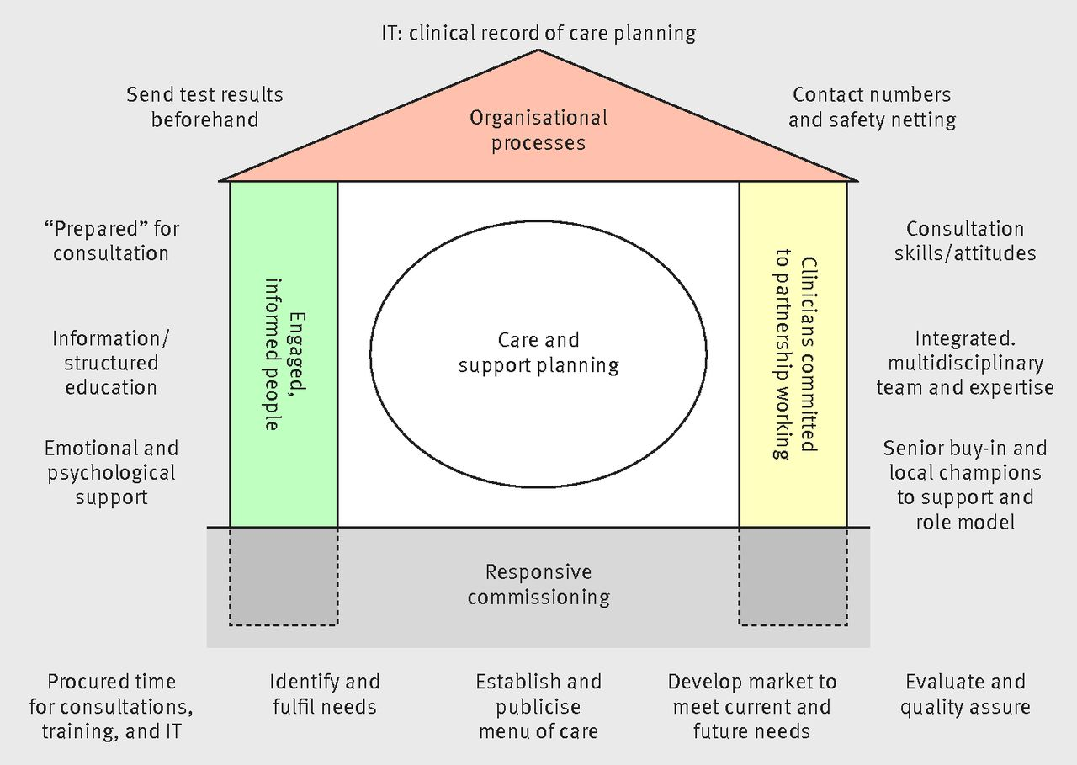
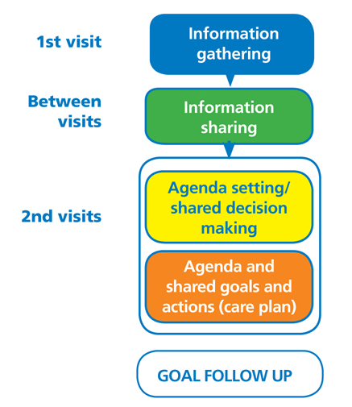
Care Planning/ Asset Focused

Slide 21
What is empathy?
www.youtube.com/watch?v=rbxb3DcaohU

Slide 22
Do you care enough to change?
www.kingsfund.org.uk/sites/files/kf/field/field_publication_file/Caring_to_change_Kings_Fund_May_2017.pdf

Slide 23
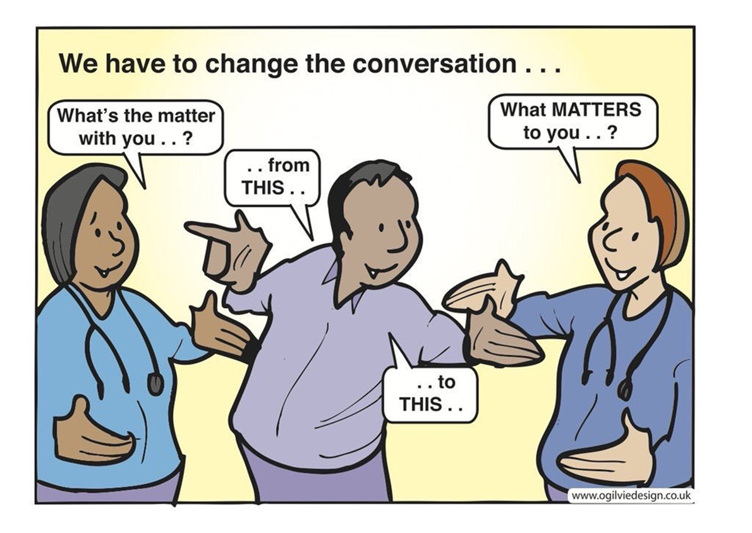
http://salusdigital.net/i-have-the-next-killer-health-app

Slide 24
Take-Homes
Think Patient, even better Person, not body part
Information Therapy
Care AND Coach
Activation & Assets > Engagement & Deficits

Slide 25
Every man is, no doubt, by nature, first and principally recommended to his own care; and as he is fitter to take care of himself than of any other person, it is fit and right that it should be so
Hatred and anger are the greatest poison to the happiness of a good mind.
No society can surely be flourishing and happy, of which the greater part of the members are poor and miserable. It is but equity, besides, that they who feed, cloath and lodge the whole body of the people, should have such a share of the produce of their own labour as to be themselves tolerably well fed, clothed, and lodged. Adam Smith, 9 March 1776

Slide 26
What do you see now?
@MarkDuman

