Slide 1
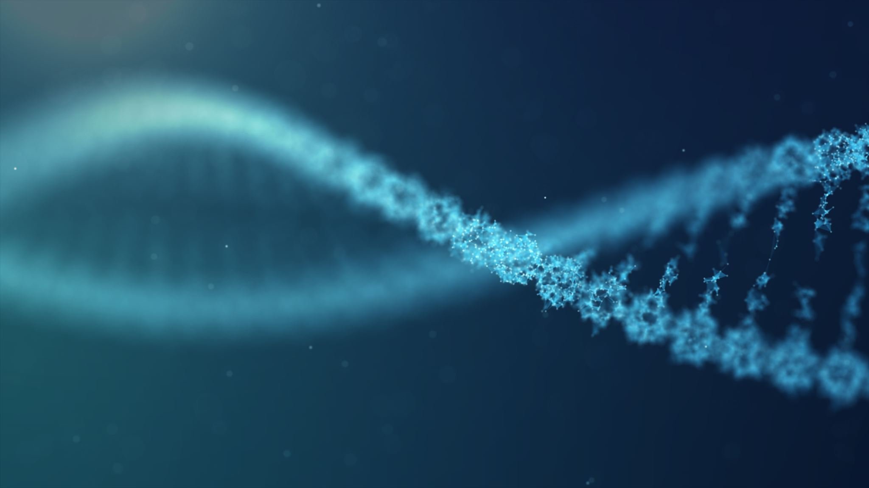
Ethical debates in medicine
Hinda Perez

Slide 2
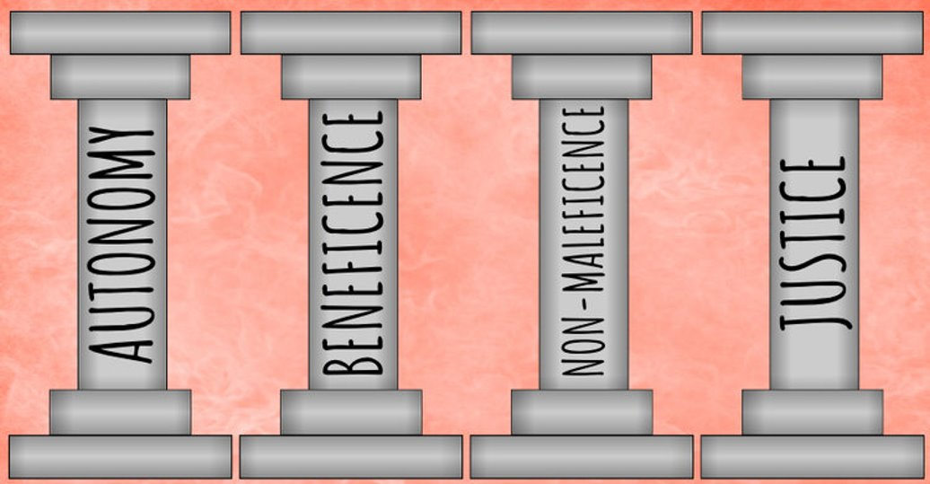

Slide 3
Should euthanasia be legal?
Intentional ending of somones life in order to alleviate pain and suffering
Active and Passive ( Withholding treatment)
It is illegal in the United Kingdom but legal in some instiutions e.g. switzerland
AUTONOMY NON -MALEFICENCE
BENEFICENCE
Arguments for:
Autonamy- patients should have the choice
Shorten suffering
Reduce resources
Allows a patient to maintain their dignity
Against:
Playing God
If they prerequest eunathasia they may later be unable to express change of mind
There have beencases of miracle recovery
Difficult to lawfully set criteria
Open to system abuse and pressure

Slide 4
Should self caused diseases be treated on the NHS?
Obesity linked diseases, lung cancers from smoking, Liver cirrhosis from alcohol intake.
In an ideal world where we had the funding and resources to treat everyone this wouldn't be a problem.
JUSTICE BENEFICENCE NON MALEFICENCE
Yes
Justice requires we don't discriminate against a persons background and treat them regardless.
Difficult to separate disease categories – very few diseases are just genetically linked.
Difficult to determine if a disease is self-inflicted
Necessary to treat transmitted diseases for public health
NHS should work alongside a free society.
Sometimes people who smoke and drink are some of the most vulnerable and can come from low socio-economic backgrounds which isn't their fault.
No
Often relapse to high risk behaviour
Removes responsibility
When resources are budgeted and people prioritised some people may be more "deserving" then others

Slide 5
Do waiting hour targets do more good then bad?
A and E – 4 Hours
Non urgent consultation – 18 weeks
Cancer referral – 2 weeks
BENEFICENCE
NON MALEFICENCE
JUSTICE
Negatives:
Could reduce the quality of care
Could lead to things being overlooked in order to reach a target
Doesn’t benefit all patients equally – goes against justice
Increases staff workload pressures
Reduces communications between primary and secondary care
Impact patient's safety
Positives:
Waiting times have been reduced
Improve efficiency
Reduce the bed block pressure
Crowding is risked to higher mortality
Ensures degenerative illness are treated sooner
Forces prioritisation
Increase public confidence and public satisfaction
Incentive to improve staffing and management along with moral

Slide 6
Should everyone be screened for the highest risk cancers ?
Screening is testing people who are at higher risks of diseases to see if they show signs of them so they can be treated earlier which is often more effective.
e.g.Mammographys and smear tests
BENEFICENCE NON MALEFICNECE AUTONOMY
Negatives
False positives- unnecessary further testing and physcological impact
Could lead to very difficult decisions which some people may not be able to face
It could detect a "small cancer" which wouldn't have had an affect in the persons lifetime - a person could undergo aggressive treatment which is both mentally and physically stressful.
People may not be offered the correct counselling services
Positives
Reduces
the risk of developing a condition or complications from it
Allows people to make informed choices
More effective treatment
Proven to save lives, lengthen life spans, and improve quality of life

Slide 7
Is it right to change organ donation to opt out?
In 2020 organ donation will be opt out – Max and Keira's law
This means that instead of actively registering to donate, donation will be presumed unless stated otherwise
It has consistently higher success rates in countries like Australia- 99.98 percent consent
BENEFICENCE JUSTICE NON MALEFICENCE
Postives
Lots of people would be willing to to donate but either aren't educated about it or don't think about it
Increases the number of organs available to save lifes where as now people die on waiting lists
Negatives:
Likewise a person may wish to opt out but may not be able to – removes autonomy
Religious objections to wide organ donation – however you can opt out

Slide 8
You have one liver transplant, it can either go to a child with a liver birth defect, a single mother of three who is an alcoholic, a 40 year old surgeon or an 80 year old man. All of them have the same clinical need. Who would you give it to and why?

