Slide 1
King David Medsoc
Fiona Caplan-Dean
Pharmacy Services Development Manager UK

Slide 2
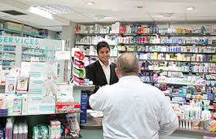
What does a Pharmacist do ?

Slide 3
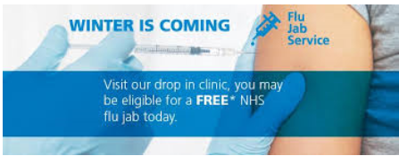
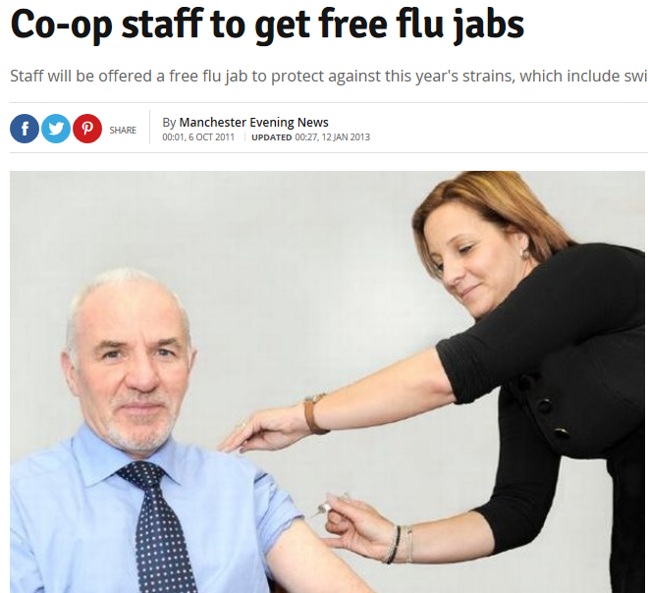
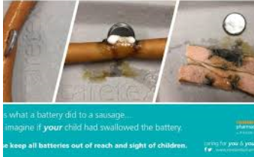
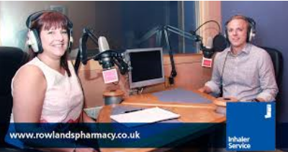
Career history

Slide 4
Pharmacy within NHS

Slide 5
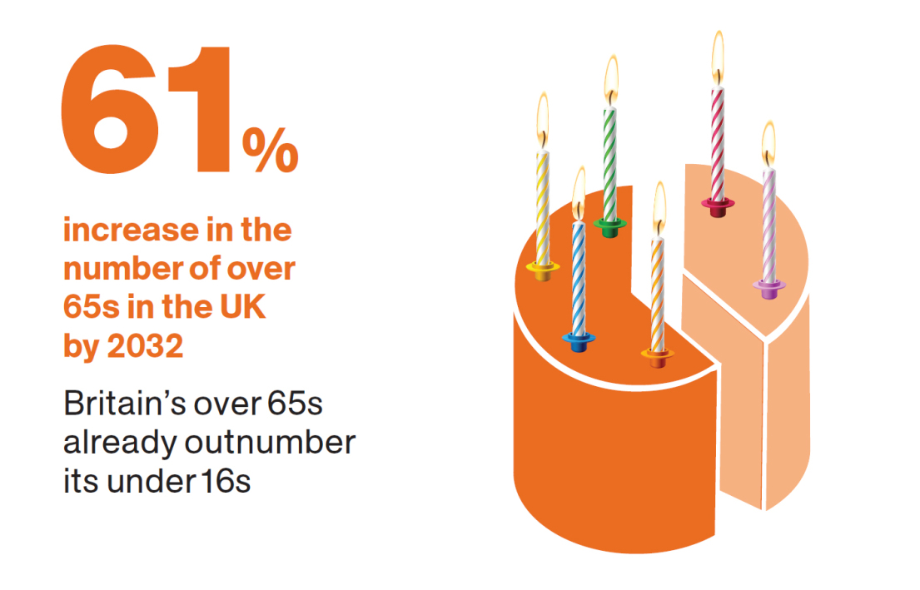
Why growing need to support more ?

Slide 6
Why services in Pharmacy ?
First point of contact
Only point of contact – Healthcare professional
Heart of the community
Only healthcare professional situated in areas of deprivation,
Community pharmacies are well-positioned to target the higher levels of obesity, smoking, and drug and alcohol misuse particularly associated with low income and deprivation
Pharmacists are highly trained, skilled professionals who are part of the public health professional network
Notes:
Pharmacies are ideally placed in the heart of
the community to access ‘hard to reach’ groups
and thus reduce health inequalities and be
instrumental in the radical changes envisaged.
Often the only healthcare professional situated
in areas of deprivation, community pharmacies
are well-positioned to target the higher levels
of obesity, smoking, and drug and alcohol
misuse particularly associated with low income
and deprivation (3).
Pharmacists are highly trained, skilled
professionals who are part of the public health
professional network and the potential to use
pharmacy teams more effectively to improve
health and wellbeing and reduce health
inequalities has been identified (1). As a patient
facing service, pharmacy has a number of key
attributes that fit well with promoting public
health and preventative healthcare messages
and delivering public health services to a wide
cross-section of society.
Enhanced pharmacy services, which include stop
smoking services, sexual health and weight loss
programmes, have been shown to be an underutilised
resource that can deliver innovative,
cost-effective public health services to patients
in a highly accessible manner. These services
can also help the NHS achieve its Quality,
Innovation, Productivity and Prevention (QIPP)
objectives (5).
Public health is included within the current NHS
community pharmacy contractual framework in
England. Pharmacies already give proactive
advice on wellbeing issues to people presenting
prescriptions with diabetes, those at risk of
coronary heart disease (particularly those with
high blood pressure) and those who smoke or
are overweight. In addition, they also provide
advice and support for carers to help them in
their caring roles. Each year pharmacies
participate in up to six health promotion
campaigns at the request of the PCT, to
promote public health messages to the public
visiting the pharmacy during specific targeted
campaign periods (6). Nationally, Public Health
England will influence the future contractual
framework and locally commissioned services of
the future (2).
It is important that NHS organisations
continue to maintain and develop
pharmaceutical services, including local
enhanced services to meet pharmaceutical
needs… Evidence continues to build
f

Slide 7
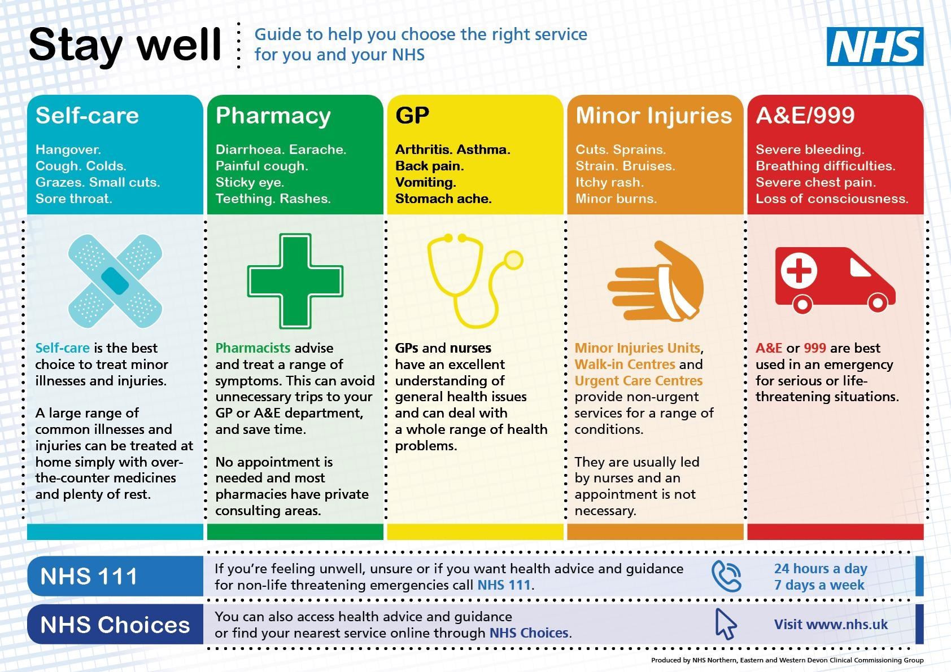
Supporting people with self care

Slide 8
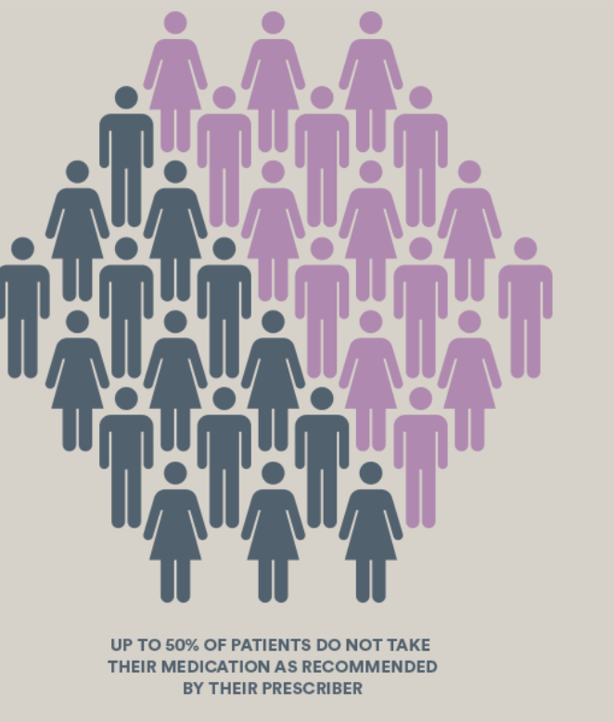
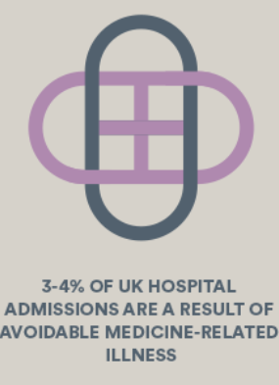
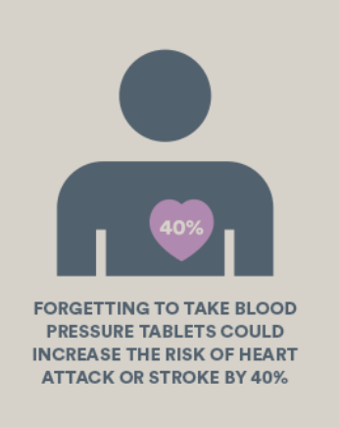
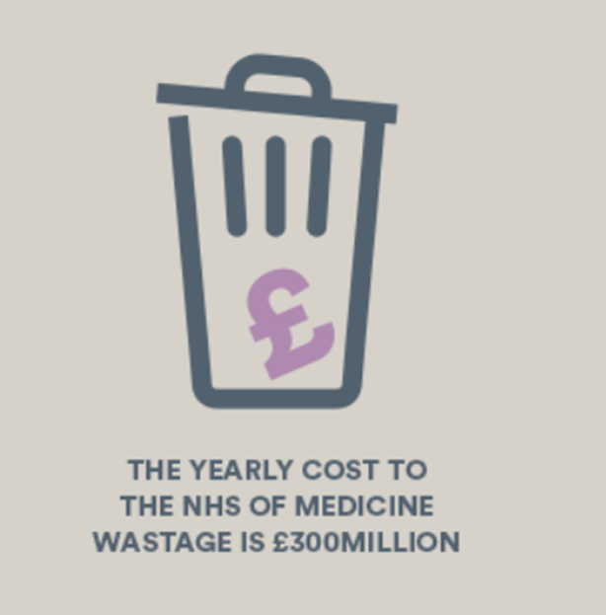
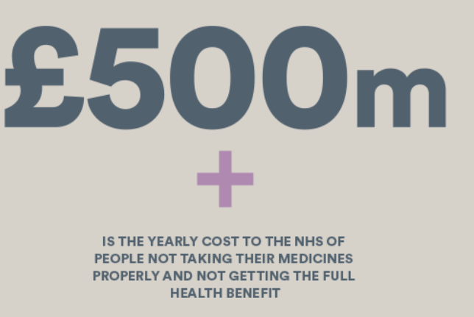
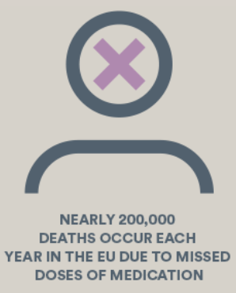
Supporting people with medicines

Slide 9
Services
Developed
Commissioners eg CCGs
Pharmaceutical Companies
NHS national services

Slide 10
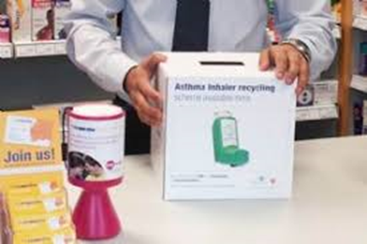
68% increase in Asthma control

Slide 11
Asthma
5.4 million people in the UK are currently receiving treatment for asthma: 1.1 million children (1 in 11) and 4.3 million adults (1 in 12).
UK still has some of the highest rates in Europe and on average 3 people a day die from asthma.
In 2016 1,410 people died from asthma.
The NHS spends around 1 billion a year treating and caring for people with asthma.

Slide 12
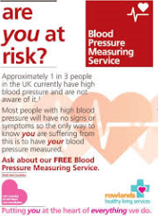
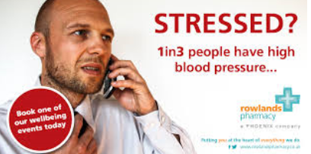

Slide 13
BP/ AF Services
There are 9.5 million people in the UK diagnosed as having high blood pressure, also known as hypertension. That is 1 in 7 people in the UK.
For every 10 people diagnosed with high blood pressure, seven remain undiagnosed and untreated - this is more than 5.5 million people in England alone.
Treatment for high blood pressure significantly reduces the risk of heart attacks, stroke and heart failure: Every 10mmHg reduction in systolic BP reduces the risk of major cardiovascular events by 20%.
High blood pressure is a contributing factor in around half of strokes in England, Wales and Northern Ireland.

Slide 14
Vaccination Services
70 million trips
50% don’t get advice
<5% of GPs offer
243 cases of malaria
14 cases of cholera
92 cases typhoid

