Slide 1
The Bma & the GMC

Slide 2
Overview
Differences between the BMA and the GMC
Roles of the BMA and the GMC

Slide 3
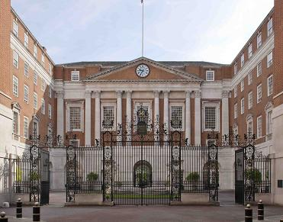
The BMA (British Medical Association)
Founded on the 9th July 1832
The BMA headquarters are located in Tavistock Square London
The BMA is the professional association and registered trade union for doctors in the United Kingdom. (They represent doctors to the government).
It does not regulate and certify doctors.
Professor Dinesh Bhugra CBE is the current President of the BMA Council.

Slide 4
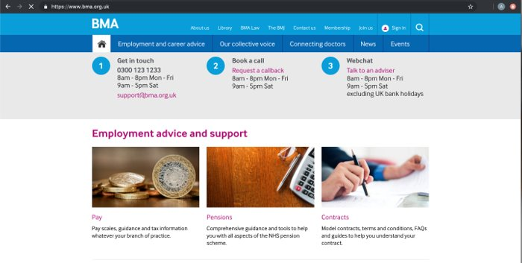
Members of the BMA have access to expert employment advice.
Advisors can help with a range of employment related issues, from answering a simple question to advising on more complex problems including:
contract checking,
job planning,
pay disputes
relationship issues.

Slide 5
Members are also entitled to free resources from the BMA for example the BMJ, a free subscription to The BMJ.
The BMJ is an advocate of evidence based medicine. It publishes research as well as clinical reviews, recent medical advances, editorial perspectives, among others.

Slide 6
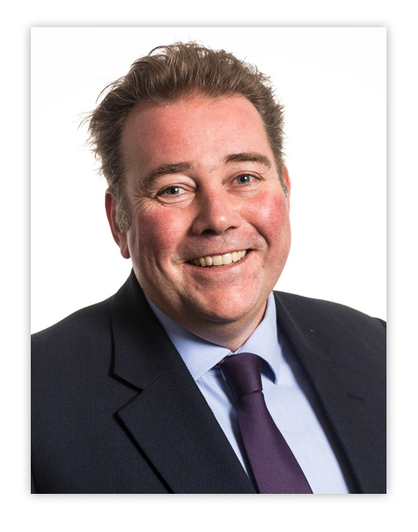
The GMC (General Medical Council)
The General Medical Council (GMC) is a public body that maintains the official register of medical practitioners within the United Kingdom.
Founded in 1858, 26 years after the BMA
Charlie Massey – Chief Executive
Council is made up of six medical professionals and six lay (non-medical) members.

Slide 7
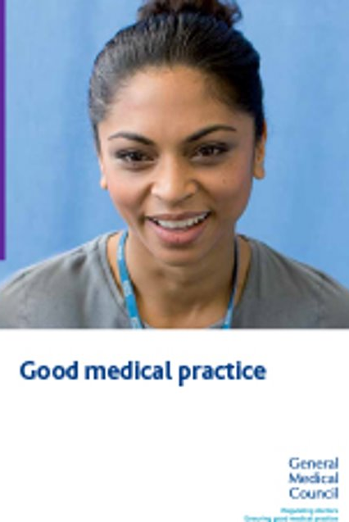
Its chief responsibility is to "protect, promote and maintain the health and safety of the public" by controlling entry to the register, and suspending or removing members when necessary.
Prime objective is to look after the general public.
The GMC sets the standards of good medical practice.

Slide 8
Good Medical Practice
The duties of a doctor are summarised in these four headings:
Knowledge, skills and performance
Safety and quality
Communication, partnership and team work
Maintaining trust

Slide 9
The GMC website is open to the general public.
Anybody with access to the GMC website is able to find the full register of medical practitioners.
If a patient feels they were wrongly treated, they have full access to contact the GMC and the GMC will enquire to see if the specific doctor has been practicing incorrectly.
There is also a list of all suspended doctors on the GMC website available for the general public.
This all maintains the public's trust in doctors.
Medical students also have to abide by the GMC's code of conduct
https://www.gmc-uk.org/

Slide 10
How the GMC and the BMA interact
Example 1
The GMC Good Medical Practice Guide explains that a doctor has a duty to keep their professional knowledge and skills up to date.
The BMA might then provide monthly lectures or other learning opportunities for doctors to help them meet the GMC's requirements.
Example 2
The BMA, who's prime role is to advise doctors, may decide to recommended a reduction of working hours.
The GMC, who's prime objective is to keep patients safe, would only be concerned if this put patients at risk,

Slide 11
Summary
The BMA (British Medical Association) is the union that represents doctors to the government and Department of Health, providing them with learning opportunities and professional advice.
It does not regulate and certify doctors.
The GMC (General Medical Council) is an organisation that’s prime role is to look after patients and the quality of their treatment. They do this by ensuring all medical practitioners are upholding to their duties of good medical practice.

