Slide 1
A Medical Degree

Slide 2
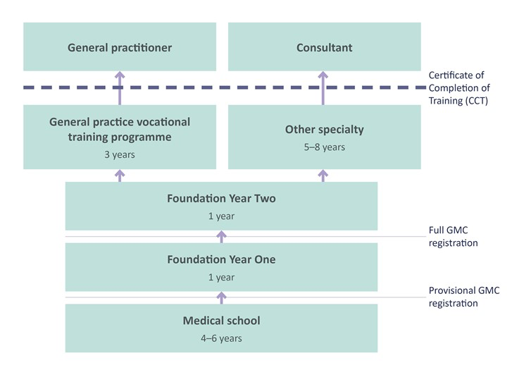

Slide 3
ANESTHESIOLOGY
MEDICAL GENETICS
PREVENTIVE MEDICINE
ALLERGY & Immunology
RADIATION ONCOLOGY
DERMATOLOGY
NUCLEAR MEDICINE
NEUROLOGY
DIAGNOSTIC RADIOLOGY
OBSTETRICS AND GYNaECOLOGY
Medicine
SURGERY
UROLOGY
EMERGENCY MEDICINE
OPHTHALMOLOGY
PATHOLOGY
PaEDIATRICS
PSYCHIATRY
INTERNAL MEDICINE
GENERAL PRACTICE ​
PHYSICAL MEDICINE & REHABILITATION

Slide 4
Colon and rectal surgery
Ophthalmic surgery
General surgery
Thoracic Surgery
Gynecologic oncology
Vascular surgery
Neurological surgery
SURGERY
Plastic surgery
Orthopaedic surgery
Oral and maxillofacial surgery
Otolaryngology
Otology neurotology
Pediatric surgery

Slide 5
Pediatric surgery
Neonatal
Prenatal
Trauma
Paediatric oncology

Slide 6
But what if you decide you do not want to do medicine?

Slide 7
Medical research
Medical lecturer
Clinical Forensic Medical Examiner
Medical/ Pharmaceutical Researcher
Medical Sales Representative
Medical Legal Advisor
Transplant Coordinator
Radiology/Diagnostic Imaging Director
Investment banker

