Slide 1
DENTAL IMPLANTS AND BIOMATERIALS

Slide 2
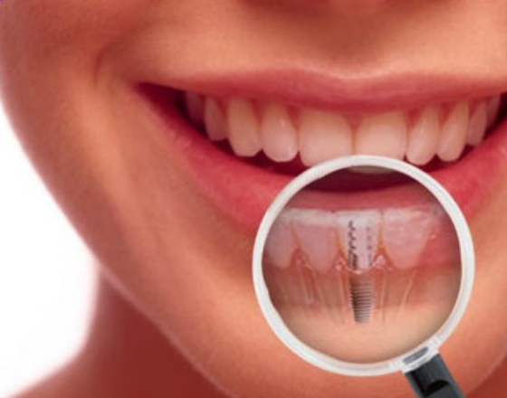
Brief history...
Chinese 4000 years ago carved bamboo sticks in the shape of pegs and drove them into the bone for fixed tooth replacement
Incas Dynasty took pieces of sea shells and tapped them into bone to replace missing teeth
Branemark- 1952 Father of modern dental implantology

Slide 3
How they are used

Slide 4
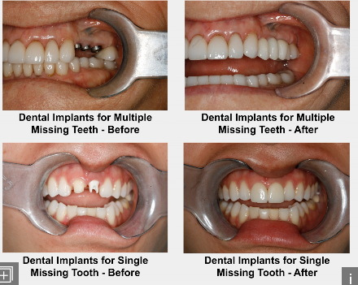

Slide 5
MATERIALS
Most dental implants are fabricated out of Titanium to very specific and accurate tolerances.
Titanium has been used as the material of choice for over 35 years and has proven to be the material of choice due to the long term success they have shown and the fact that Titanium is very biocompatible.
Some implants are coated with Hydroxyl apatite (What bone and teeth are made of) in hopes that they will fuse, or integrate, sooner and more thoroughly when placed in bone, but most studies suggest that it not necessary.
In the last few years, monolithic Zirconium-oxide implants have been introduced as an alternative to Titanium for those concerned about the metal used with the Titanium implants. Although these look promising, as with all new products, long term testing and stability is still necessary to state that they can truly be an ideal alternative for titanium implants.
What materials are dental implants made of?
The crown, or cap, is attached to the implant itself by means of an “abutment”. The abutment is screwed into the implant itself, usually after the implant has integrated to the bone. The abutment can be made out of metal, Zirconium-oxide, or a combination of the two.
Although metal has provided an excellent option for many years, the fact that it is dark in color limits what material the crown can be made of. Usually metal abutments are utilised in the back of the mouth and then the overlying crown is either a metal-reinforced crown or an opaque all-ceramic crown. In the anterior of the mouth, where natural-appearance of the final result is paramount, usually a tooth-colored zirconium-oxide or a zirconium-oxide overlaid on a titanium base is used. This abutment allows for the use of a very translucent and more natural appearing all-ceramic crown is utilised and will provide the best aesthetic results.

Slide 6
Titanium is considered the most biocompatible metal due to its resistance to corrosion from bodily fluids, bio-inertness, capacity for osseointegration, and high fatigue limit. Titanium's ability to withstand the harsh bodily environment is a result of the protective oxide film that forms naturally in the presence of oxygen. The oxide film is strongly adhered, insoluble, and chemically impermeable, preventing reactions between the metal and the surrounding environment.

Slide 7
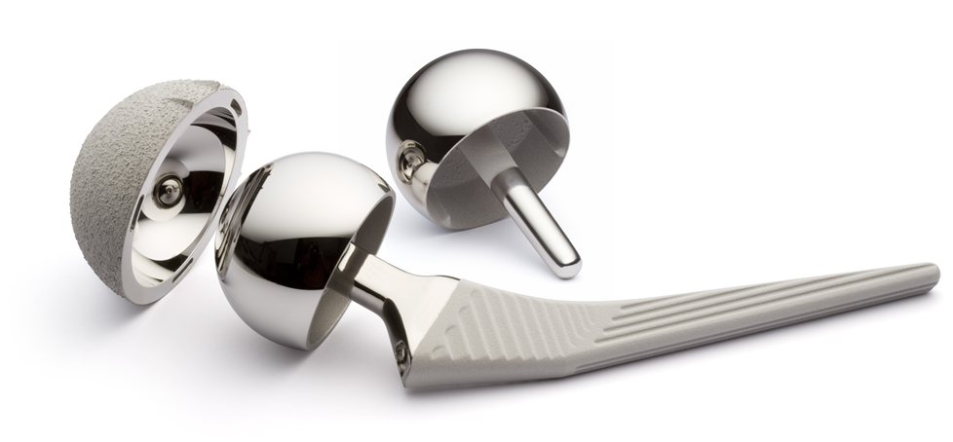
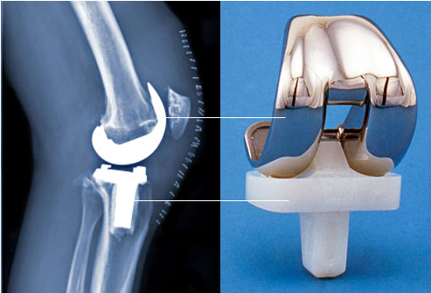
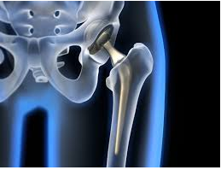

Slide 8
STATS

Slide 9
Who qualifies for dental implants? In general, a person who is missing a tooth is qualified for dental implant surgery. Whether you have lost the tooth to severe decay, lost it in an accident, or your dentist needed to extract the tooth because of disease or decay, you will be left with a gap in your dentition.
A dentist may insist that you are healthy enough to undergo the procedure, however. You must be generally healthy for the implant to properly bond to your jawbone. Many elderly patients may find that they do not qualify as candidates for this procedure because of the loss of bone density. Others may be rejected as candidates if they have other medical conditions such as active diabetes, cancer, or periodontal disease. These circumstances make the procedure a health risk.

Slide 10
Implants... On the NHS
Add info
Does insurance cover the procedure? Although this procedure may be seen as necessary, most gaps can be temporarily fixed with the use of a bridge or dentures. Some insurance companies do not see this as a necessary oral health procedure. Others are particular as to which tooth it is and whether the function and health of your mouth is compromised as a result of losing a certain tooth. There are plans that include optional insurance specifically for dental implants, covering you in case you need one. You need to speak with your dentist and your insurance company to see if you qualify for this procedure and whether it will be covered. How do I finance the procedure? For a single implant, you’re looking at between £ 700 to £3,000 depending on the specifics of your health and which tooth needs to be replaced. If you need several dental implants, you could spend as much as £ 7,000.
If you are unable to get augmentative insurance for this surgery, many oral health offices can help you finance the procedure. There are also third party lenders that work specifically with medical loans for this type of elective procedure. You can also secure personal loans or work with a credit card company willing to offer you a low interest rate on medical expenses. If you’re unsure if you qualify for this procedure and are not sure how to go about paying for it with or without insurance, speak to your dentist or ask that you be referred to a specialist. The first consultation with the doctor will help you decide if getting dental implants is the right course of action for you.

Slide 11
Dentures or false teeth
More commonly known as false teeth, dentures are fitted in place of natural teeth. A full set is used to replace all your teeth. A part set is used to replace one or more missing teeth. Dentures are custom-made using impressions (mouldings) from your gums. They're usually made from metal or plastic.
They're removable so you can clean them, although part dentures can be brushed at the same time as your other teeth. A full set needs to be removed and soaked in a cleaning solution.
Dentures are important if you lose your natural teeth, as losing your teeth makes it difficult to chew your food, which will adversely affect your diet and may cause your facial muscles to sag.

Slide 12
Advantages and Disadvantages
Advantages
Disadvantages
Dental implants reduce the stress on the remaining teeth by offering independent support and retention for crowns, bridgework and over dentures.
Dental implants preserve natural teeth by avoiding the need to cut down adjacent teeth for conventional bridgework.
Dental implants preserve bone that results in loss of jaw height and the appearance of aging.
Long-term data suggests that implants last longer than conventional bridgework.
Implants can also be used to secure removable partial and full dentures.
Implants will allow you to chew better and speak more clearly.
Implant restorations are very natural appearing and easy to clean and maintain.
A surgical procedure is necessary for implant placement.
There may be insufficient bone for implant placement. This may necessitate bone grafting and additional expense.
While implant fixtures (roots) have a 95% success rate, a porcelain crown placed on the implant may still fracture with time.
Initial implant expense may be costly, but in the long term, is actually more cost-effective.

Slide 13
peri-implantitis
Peri-implantitis is an inflammatory disease marked by bacterial infection and the gradual loss of the jaw bone supporting the implant. It’s not yet clear whether the infection causes the bone to recede, or the bone loss exposes the area to bacteria. Dentists are uncertain how to treat it. Ten years ago, professionals said the condition didn’t exist. But now it is on the rise, as increasing numbers of people have replacement porcelain crowns with titanium roots.
Half-a-million adults have at least one dental implant, according to the latest Adult Dental Health Survey.
Studies have suggested that one third of patients will be infected. “We’re sitting on a time bomb,” says Dr Stephen Jacobs, a past president of the Association of Dental Implantology and well-respected implant surgeon. “We are going to be seeing more and more cases.”
Peri-implantitis is always preceded by a much milder disease, called peri-implant mucositis, which is common and treatable. Early warning signs are red, swollen gums and bleeding when probed. If undetected and untreated, it might become peri-implantitis.
Because bone loss is painless, many people don’t realise they have the condition. So scrupulous oral hygiene and regular follow-up appointments after an implant are essential, says Dr Jacobs, who runs a Glasgow clinic. Paradoxically, the rise in cases is mostly due to advances in implant design. In the mid-Nineties, clinicians found that implants with a rough instead of a smooth surface integrated better with the bone. However, the textured surface is more likely to harbour bacteria if the bone shrinks away from it.

