Slide 1
The Gut
Talia Ronen

Slide 2
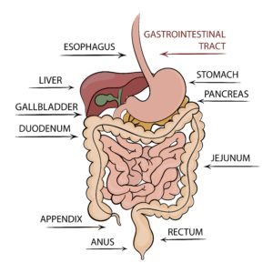

Slide 3
The Gut
Why should we learn about the gut?
The gut can effect our health and well-being
It even influences the brain
By learning more about the gut we can come to a better understanding of many physical and psychiatric illnesses as well as improving and developing treatments for them.

Slide 4
The Gut
Enteric means relating to or occurring in the intestines
The enteric nervous system (ENS) has the largest accumulation of nerve cells in the human body
The ENS produces more than 30 neurotransmitters
It releases hormones and peptides that cross the blood-brain barrier

Slide 5
The Gut
Approx 95% of Serotonin is produced by enterochromaffin cells which reside alongside the epithelium lining the lumen of the digestive tract
Regulation of appetite, sleep, feelings of well being
Some bacteria in our gut produce GABA (gamma-Aminobutyric acid)
Inhibits neural activity in the brain
Reduces anxiety
Psychobiotics are bacteria, when ingested in adequate amounts, produce mental health benefits

Slide 6
The Gut
The microbiome is considered an organ of the body
Bacteria, achaea, fungi
Digests and ferments food we cannot digest (e.g. fiber)
Produces vitamins
Protect against harmful bacteria
Faecal microbiota transplant
To restore the balance of bacteria
GI infection, IBS, obesity

Slide 7
The Gut
The gut is refered to as the largest immune organ in the body
About 70% of the immune resides in the gut
Decreased diversity of the microbiome can lead to reduced immunity

Slide 8
The Gut

