Slide 1
THE PSYCHOLGY BEHIND ADDICTION
OLIVIA LEDERBERG

Slide 2
THE IMPACT OF FREUD
Freud studied the relationship between personality and the development of substance addiction.
He theorized that when the id overpowers the ego and superego a chain reaction occurs that can result in the consumption of drugs without the consideration of repercussions.
The iceberg model: while some parts of the mind are conscious, this being the tip of the iceberg, for the most part, the brain operates mostly on an unconscious paradigm, the latter part of the iceberg.
He therefore determined that the majority of our thoughts, emotions, desires and impulses are driven by unconscious forces.
Sigmund Freud, an Austrian neurologist, who developed a theory aiming to explain how the psychological addiction loop forms.
His psychoanalysis theory looks at addiction as an imbalance between the id, ego and superego.
The id being the pleasure principle, the ego the reality principle and the superego the morality principle.

Slide 3
BRAIN CHEMISTRY BEHIND ADDICTION
All addictions stem from the same source: the reward system.
The brain is wired to reward us when we do something pleasurable.
Limbic system, located in the brain, contains the bodies reward circuit.
When activated, each cell in this circuit relays electrical and chemical signals transmitted through neurons. The neurotransmitter, dopamine, is released across the synapse.
The consumption of drugs can cause a dopamine surge 2-10 times greater than a normal release. According to the NIDA “large surges of dopamine ‘teach’ the brain to seek drugs at the expense of healthier activities and goals”.
The pleasure felt due to drug consumption is the motivation that leads an addict to repeat drug taking behaviours, depending on how potent the drug is, neuronal adaptations begin to emerge resulting in drug dependency.
Studies have shown that consistent drug use severely limits a persons capacity to feel pleasure. As the brain develops a decreased sensitivity of the reward system to natural reinforcers. Extensive drug use results in much smaller amounts of DA being released; the brains reward circuit becomes less receptive to enjoyment from both drugs and ordinary environmental stimuli.

Slide 4
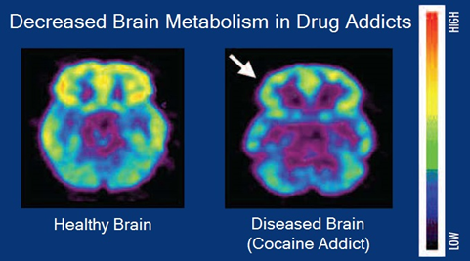
BRAIN CHEMISTRY CONTINUED….
Once the brain has been altered by drug use it requires more and more of the substance to even function at a baseline level.
This is why addicts seek drug stimulation as a means to temporarily active these reward circuits. As the neurons have already begun reducing the number of DA receptors and/or making less DA, overall, resulting in less dopamine signalling in the brain.
Coupled with a decreased sensitivity of reward circuits the brain enhances sensitivity of memory circuits to conditioned expectations of drugs and drug cues as well as weakening the control circuit.
When exposed to drugs an unrestrained hyperactivation of the motivation circuit results in the compulsive drug intake that characterises addiction.
The image above displays a PET scan, comparing brain metabolism of a healthy individual and an individual addicted to cocaine.
The addicted brain shows a decreased brain metabolism as well as structural alterations.

Slide 5
DEVELOPMENT AND TREATMENT
Young people who lack anger control are more predisposed to addictive tendencies. This is due to the fact that they are unable to identify alternative ways to diffuse the intense emotional state. Therefore, the issue of how to improve self control is pertinent to teens at risk of addiction.
Genetic factors account for around 50% of an individuals vulnerability to addiction.
As well as biological factors there are an abundance of environmental factors ranging from economic status to sexual abuse.
In teenagers the areas of the brain responsible for decision making and judgement are still developing, making teens substantially more prone to high-risk behaviours such as drug taking.

Slide 6
DEVELOPMENT AND TREATMENT CONTINUED……
Currently there is no cure for addiction, however advances in neuroscience and neurobiology allow scientists to study the brains structure and processes in more detail; to better understand the science behind addiction.
Pharmacological therapies are used to treat alcohol abuse, this includes drugs such as disulfiram as well as the FDAs recent approval of the drug naltrexone.
Behavioural and psychological therapies are more frequently used as both are deemed effective and easily accessible.
CBT AND CM (contingency management) are both used to treat substance dependency aiming to help the individual achieve a deeper awareness of themselves and their unconscious desires.
Recovery from an addiction requires a complete lifestyle change.
Treatment plans are altered and tailored to fit the individuals needs, such as addressing the underlying causes that may have precipitated the addiction as well as dealing with the adverse consequences of long term substance abuse that have negatively impacted the individuals life.

Slide 7
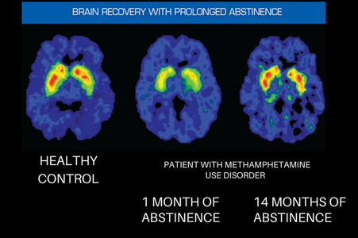
FINAL DISCUSSION
Fundamentally, addiction of any kind poses a serious threat to the individual and their external relationships
Eventually the addictive behaviours become unsustainable and chasing the high becomes mandatory even at the expense of their own health, safety and relationships.
The image below displays how the brain takes time to recover from addiction. Greater activity is shown in reds and yellows, reduced activity is shown is purple and blues.
During drug addiction the frontal cortex in particular shows decreased activity, this part of the brain is associated with judgement and decision making.
This is why early intervention is crucial in recovery, the more the brain is altered the longer it takes for the individual to recover.
Scientists continue to study the brain enhancing our knowledge and understanding of addiction thus allowing us to build the foundations for new forms of treatment.

