Slide 1
Understanding the Doctor’s Dilemma
Conditional probability

Slide 2
The doctor’s dilemma
An automated blood pressure machine tests members of the public, of whom 20% have high blood pressure on average. The machine shows that 80% of those with high blood pressure test positive and 10% of those with normal blood pressure also test positive. Find the probabilities of a) a correct positive diagnosis and b) a correct negative diagnosis.

Slide 3
It’s all in the phrasing….
The Jones have 2 children, one of whom is a girl. What is the probability that the other child is also a girl?

Slide 4
Let’s look at the possible gender distribution…
BB | GB
BG | GG
There are three equally likely instances that involve G
Only one of these is GG
$$P\left(G | G\right)=\frac{P\left(G and G\right)}{P\left(G\right)}=1/3$$

Slide 5
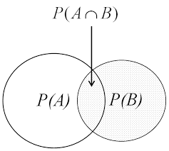
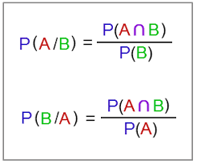
General rule for conditional probability

Slide 6
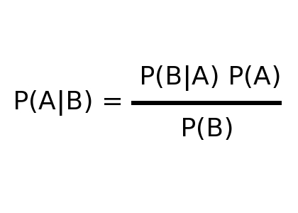
Bayes’ theorem
Posterior probability: “the probability B happens, given that A has happened
Anterior probability: “the probability A happens, given that B has happened”

Slide 7
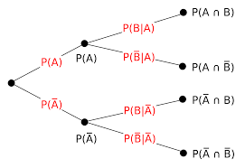
Pictured as a tree diagram

Slide 8
Back to the doctor’s dilemma
We are given $P\left(H\right)=0.2$ and $P\left(D | H\right)=0.8$and $P\left(D | \overline{H}\right)=0.1$
From these probabilities we can calculate the following:
$P\left(\overline{H}\right)=0.8 and P\left(\overline{D} | H\right)=0.2$ and $P\left(\overline{D} | \overline{H}\right)=0.9$
We require $P(H|D)$ and $P(\overline{H}|\overline{D})$

Slide 9
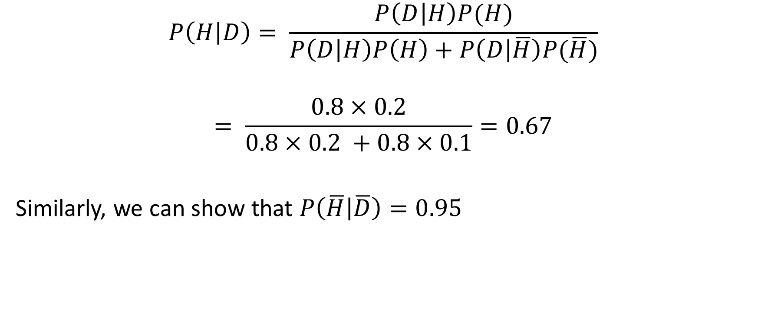
The calculation
$$P\left(H | D\right)= \frac{P\left(D | H\right)P(H)}{P\left(D | H\right)P\left(H\right)+P\left(D | \overline{H}\right)P(\overline{H})}$$
$$= \frac{0.8×0.2}{0.8×0.2 +0.8×0.1}=0.67$$
Similarly, we can show that $P\left(\overline{H} | \overline{D}\right)=0.95$

